Slide 1
Preliminary secondary QC of water column carbonate chemistry and inorganic nutrients during PS122
CTD, OXY, NUTS
WATER
IMR/NPI
INTCON
INTCOM
UEA
Primary QC
CRM
ICE
HOKU
σ
Secondary QC
AVERAGE/OFFSET
CROSSOVER
CANYON/CONTENT

Slide 2
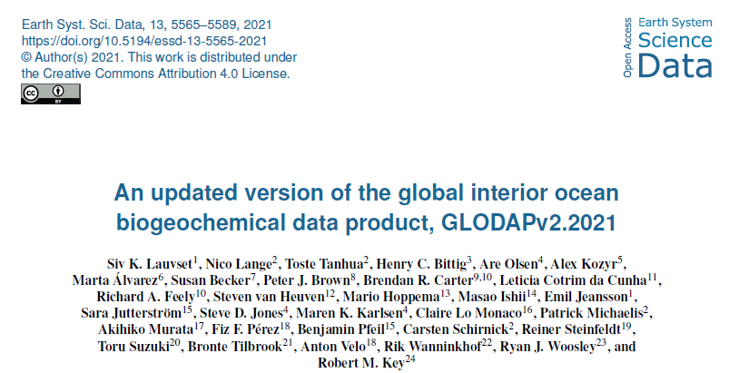
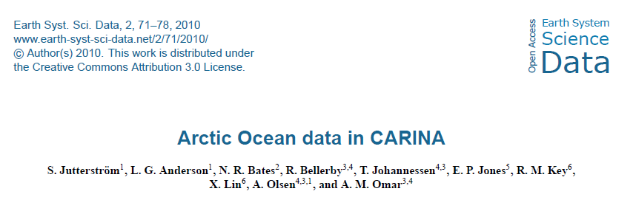
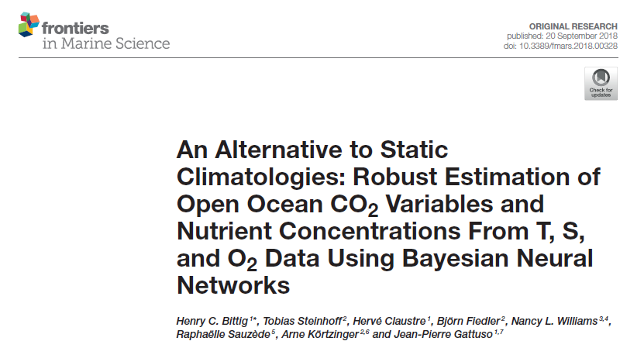
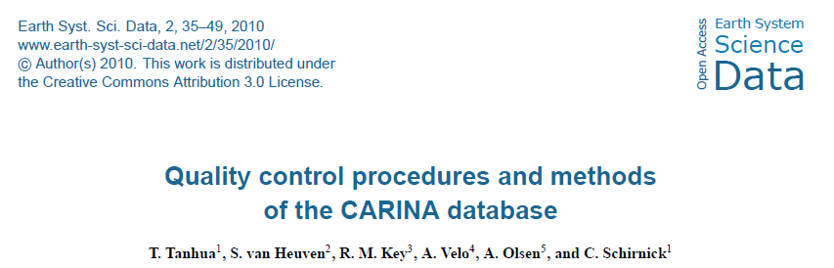
Secondary QC following GLODAP protocols
Deep water averages & MLR offset analysis
(S, T, P, OXY, NUTS, CSYS)
CANYON-B and CONTENT
Crossover analysis

Slide 3
Summary of secondary QC
Variable | GLODAP minimum adjustment | Adjustment | DEEP WATER AVG | MLR | CROSSOVER | CANYON-B | CONTENT
DIC | 4 µmol/kg | additive | -0.40 ± 3.2 | -0.1 ± 3.1 | -0.53 ± 1.5 | -2.9 ± 16.4 | -1.1 ± 13.4
TA | 4 µmol/kg | additive | 2.60 ± 2.8 | 1.1 ± 1.4 | 2.54 ± 1.3 | 2.1 ± 3.1 | 1.0 ± 3.5
Oxygen (Winkler) | 1 % | multiplicative | 0.997 ± 0.005 | 0.995 ± 0.006 | N/A | N/A | N/A
Oxygen (CTD)* | 1 % | multiplicative | 0.998 ± 0.004 | 0.999 ± 0.003 | 1.00 ± 0.00 | N/A | N/A
Nitrate | 2 % | multiplicative | 1.005 ± 0.015 | 1.001 ± 0.015 | 1.01 ± 0.01 | 0.99 ± 0.04 | N/A
Phosphate* | 2 % | multiplicative | 0.985 ± 0.025 | 0.993 ± 0.027 | 0.98 ± 0.01 | 0.95 ± 0.04 | N/A
Silicate* | 2 % | multiplicative | 1.036 ± 0.027 | 1.028 ± 0.020 | 1.03 ± 0.01 | 1.03 ± 0.15 | N/A
*Preliminary and inofficially calibrated preliminary CTDOXY against Winkler titrations *Large inter-leg variability *Too high values
No adjustments have been made to the data in 20190920.csv, except for LEG 1 TA (-23 µmol/kg) and Leg 1 DIC (-8 µmol/kg), see next slide.

Slide 4
Adjustments
Data flagging
Event_label | #Bottle | DIC (µmol/kg) | TA (µmol/kg)
PS122/1_7_49 | All | -8 | -23
PS122/1_8_46 | All | -8 | -23
PS122/1_9_50 | All | -8 | -23
PS122/1_10_45 | All | -8 | -23
Event_label | #Bottle | DIC | TA | NO3 | PO4 | Si
PS122/1_7-49 | All | 3 | 3
PS122/1_8-46 | All | 3 | 3
PS122/1_9-50 | All | 3 | 3
PS122/1_10-45 | All | 3 | 3
PS122/1-8_46 | 1 | 4 | 4
PS122/2_21-65 | 2 |  | 4
PS122/4_45-79 | 5 | 4
PS122/2_16-21 | All |  |  |  | 3
PS122/2_17-41 | All |  |  |  | 3
PS122/2_18-34 | All |  |  |  | 3
PS122/2_23-63 | 2,3,5 |  |  |  | 3
PS122/2_23-63 | 6 |  |  |  | 4
PS122/2_25-54 | All |  |  | 3
PS122/4_48-62 | All |  |  |  | 3
PS122/5_59-363 | All |  |  |  | 3
PS122/5_60-69 | All |  |  |  | 3
PS122/5_60-89 | All |  |  |  | 3
PS122/5_61-161 | All |  |  |  | 3
PS122/3_40-36 | All |  |  |  | 4
PS122/3_40-36 | 2,3,6 |  |  | 4 | 4 | 4
PS122/5_59-274 | All |  |  | 4
2 = acceptable measurement 3 = questionable measurement 4 = bad measurement 9 = not sampled
Nutrient metadata/data issues
Event_label | METADATA | CTD DATA | MEASUREMENTS | DATA
PS122/1_5_40 | NO | YES | Unidentified #ID | NO
PS122/1_5_59 | NO | NO | Unidentified #ID | NO
PS122/2_23-63 | PS122/2_22-63 | YES | YES | YES
PS122/3_31-18 | PS122/3_31-19 | YES | YES | YES
PS122/3_33-80 | NO Niskin/Depth | YES | YES | NO
PS122/3_34-65 | Mismatch | YES | Unidentified #ID | NO
PS122/3_34-77 | Mismatch | YES | Unidentified #ID | NO
PS122/3_35-25 | Mismatch | YES | Unidentified #ID | NO
PS122/3_39-16 | #ID offset | YES | YES | YES
PS122/3_39-51 | #ID offset | YES | YES | YES
PS122/3_42-32 | YES | NO | YES | NO
PS122/5_63-111 | YES | NO | YES | NO

Slide 5
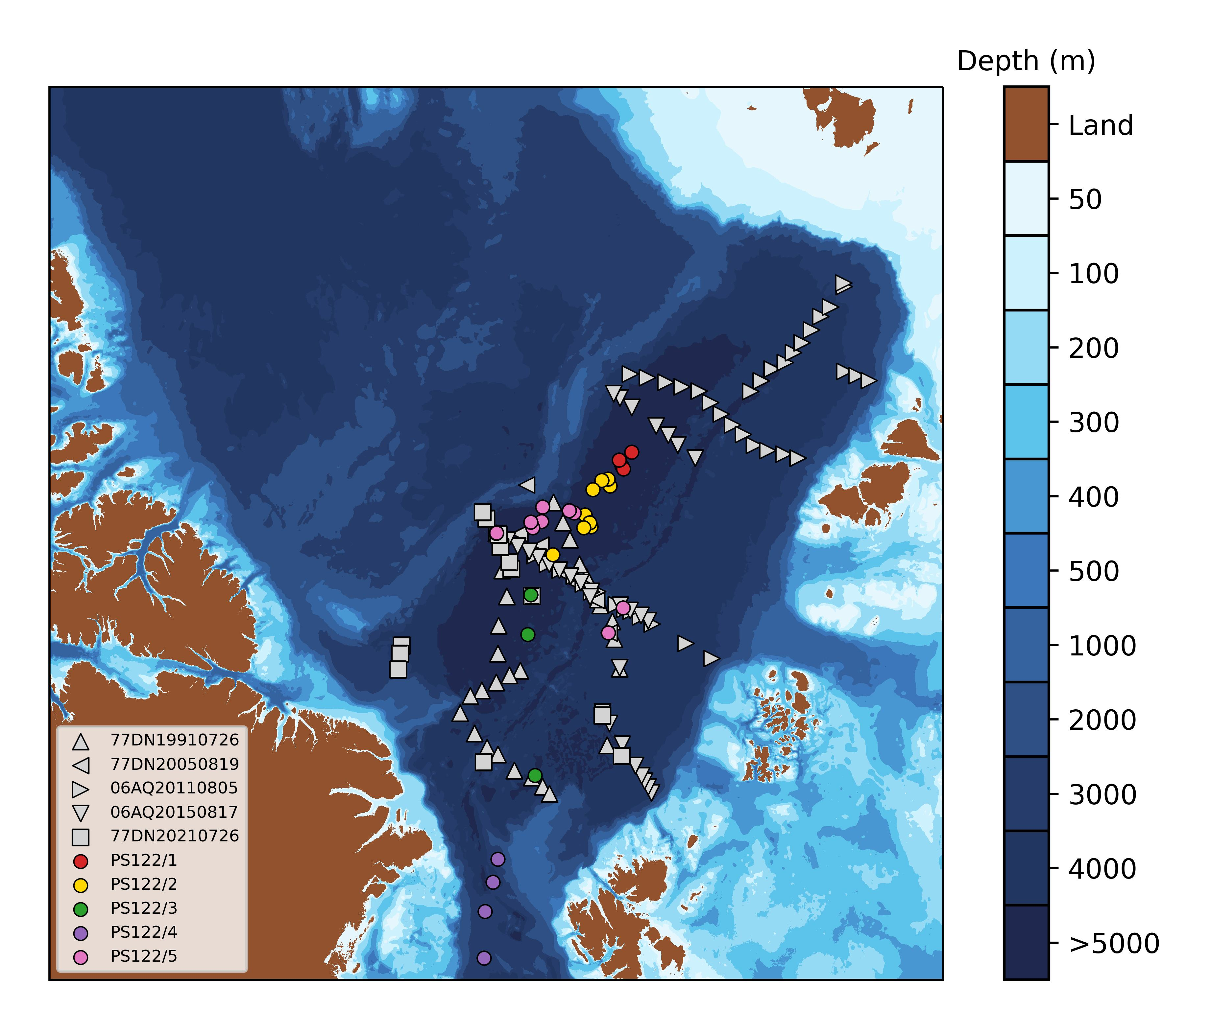
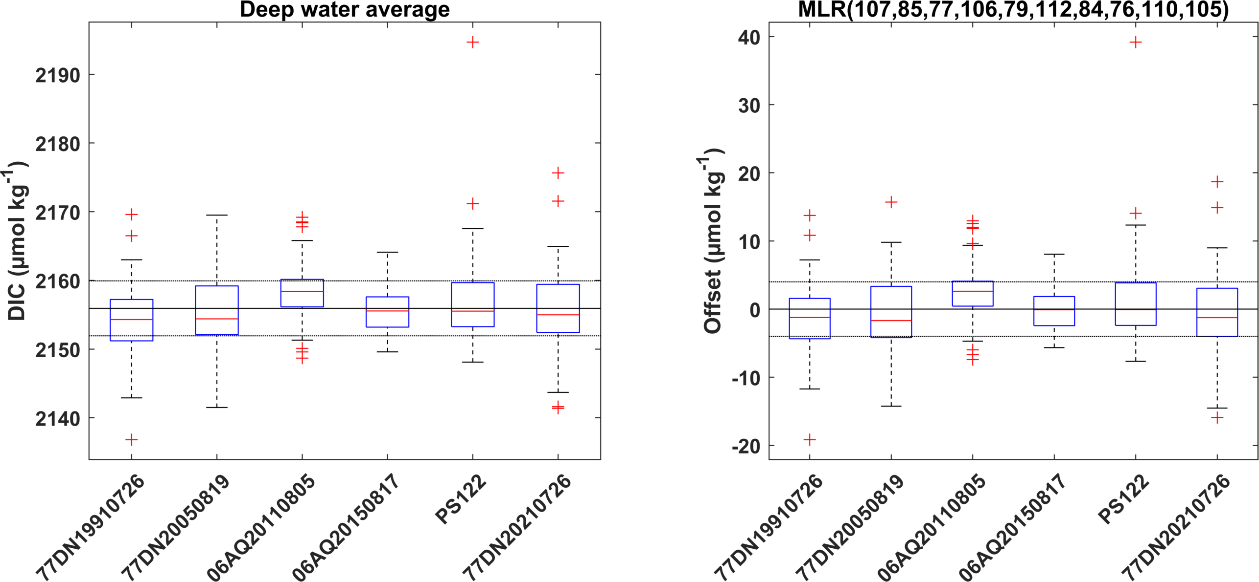
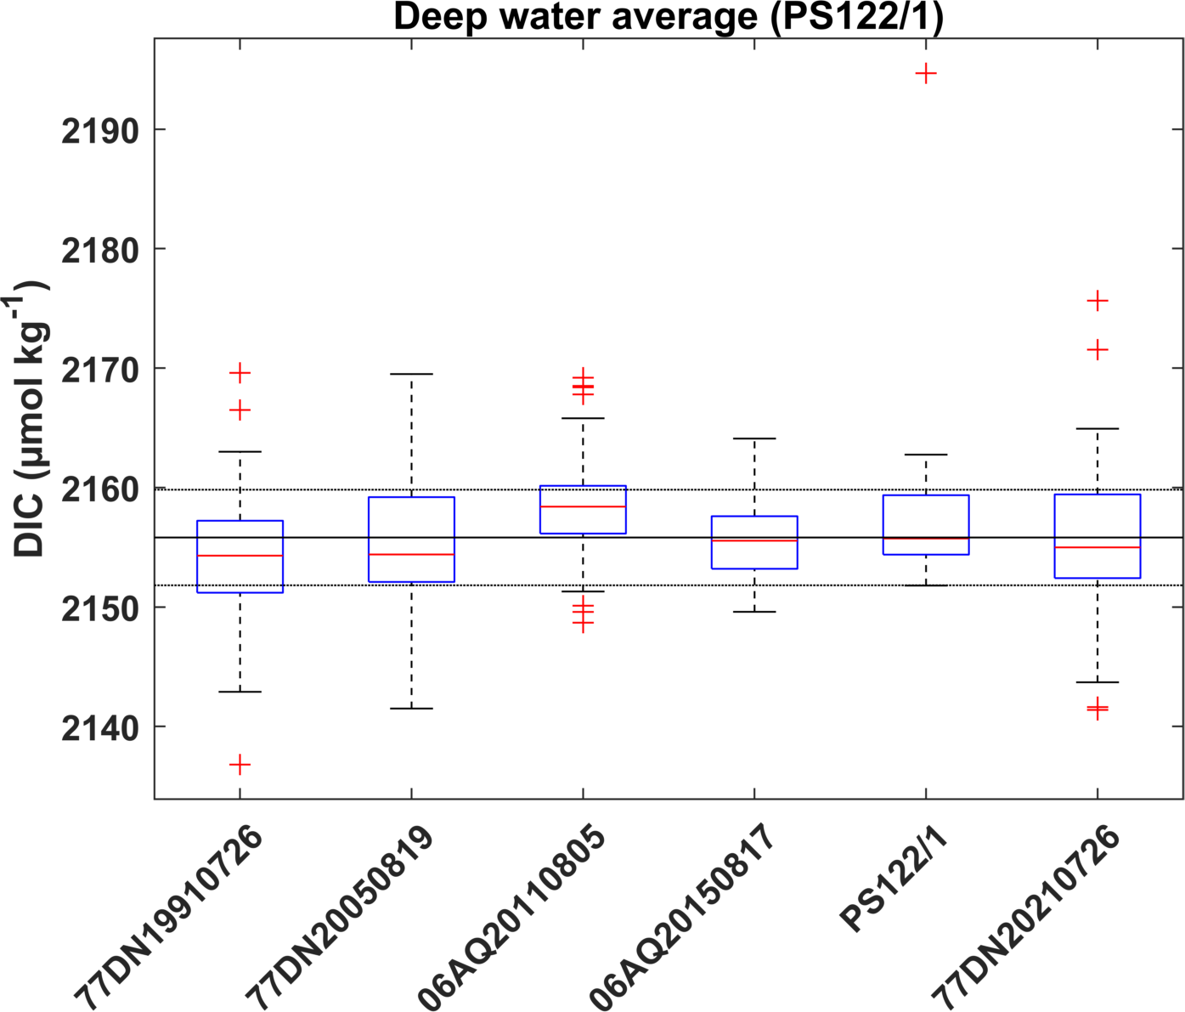
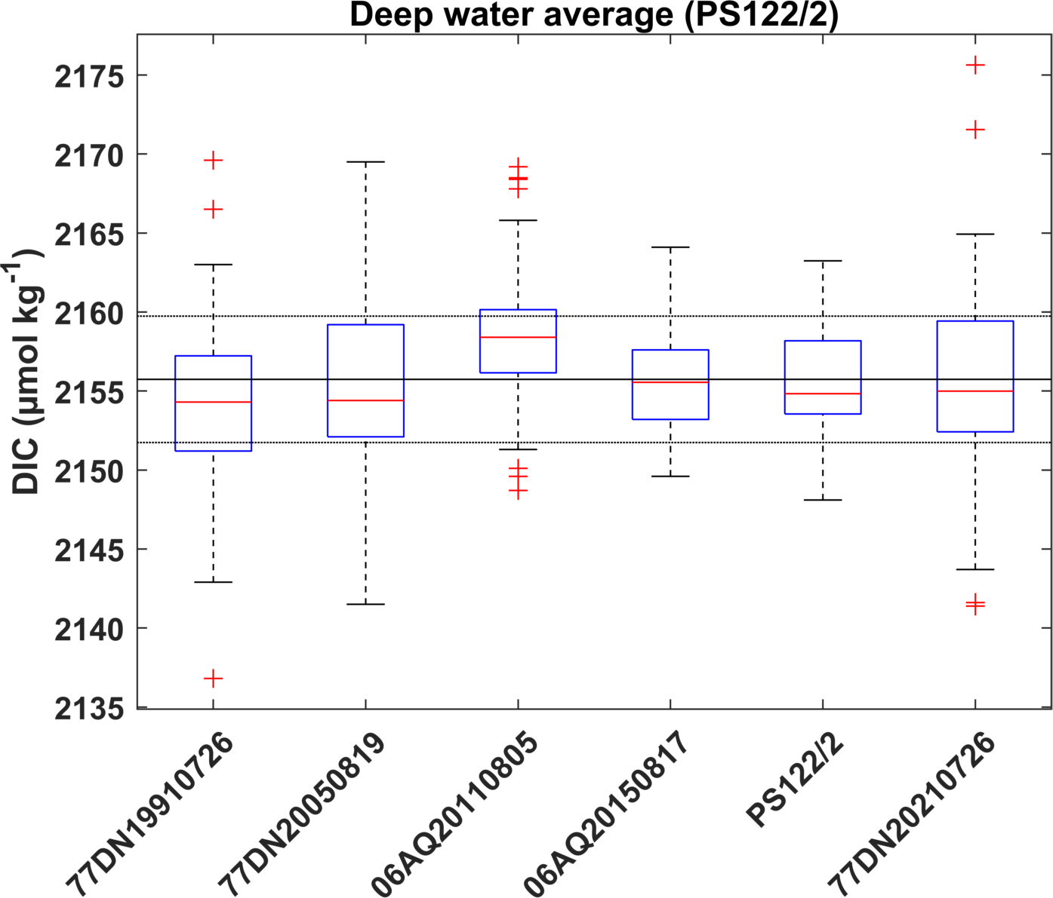
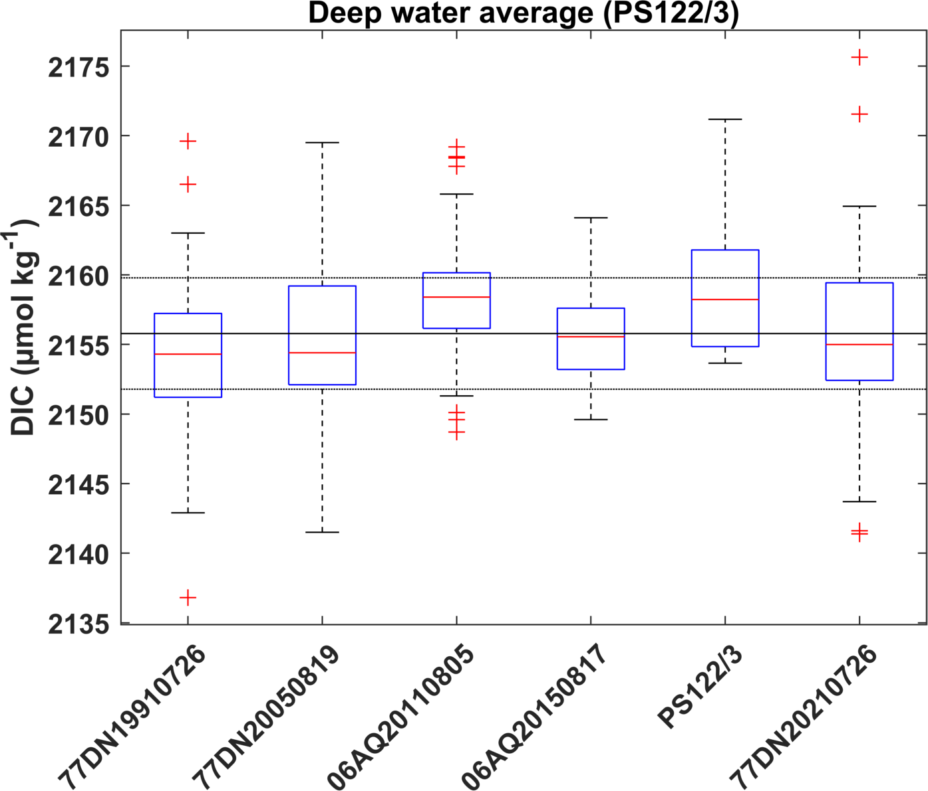
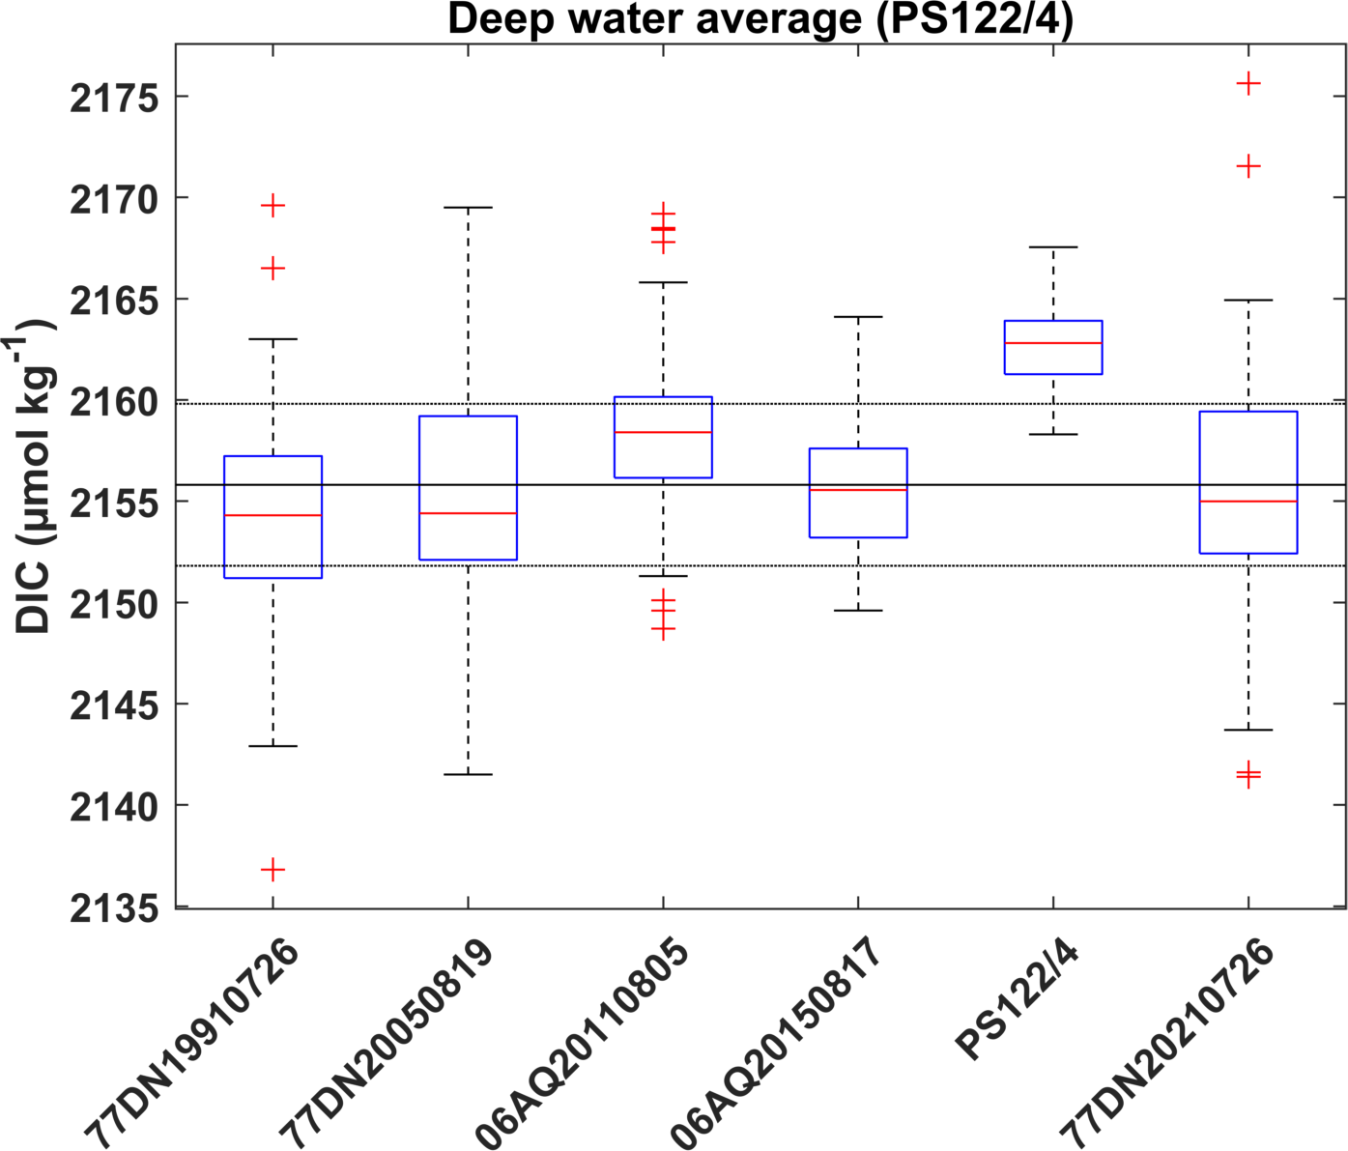
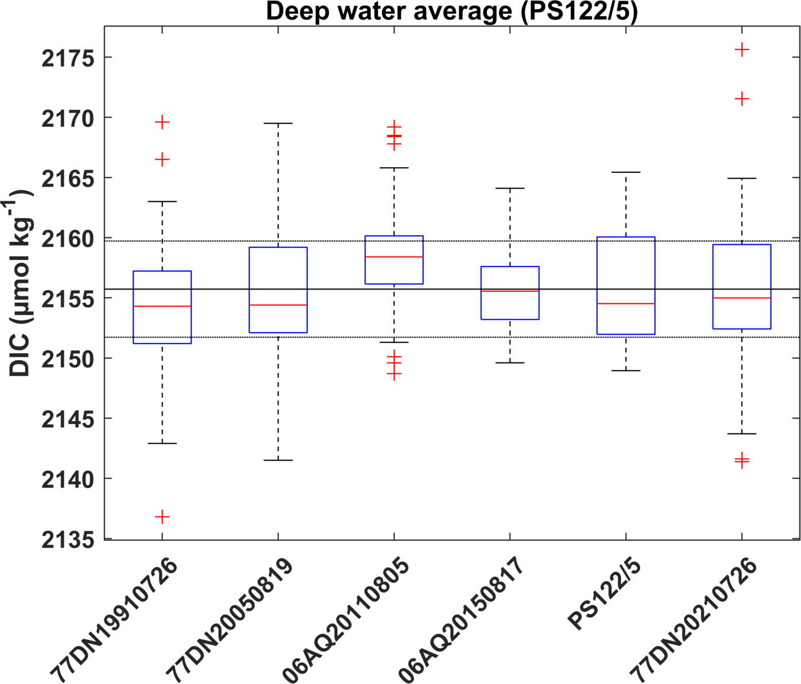
Deep water averages & MLR offset analysis (> 2500 m)

Slide 6
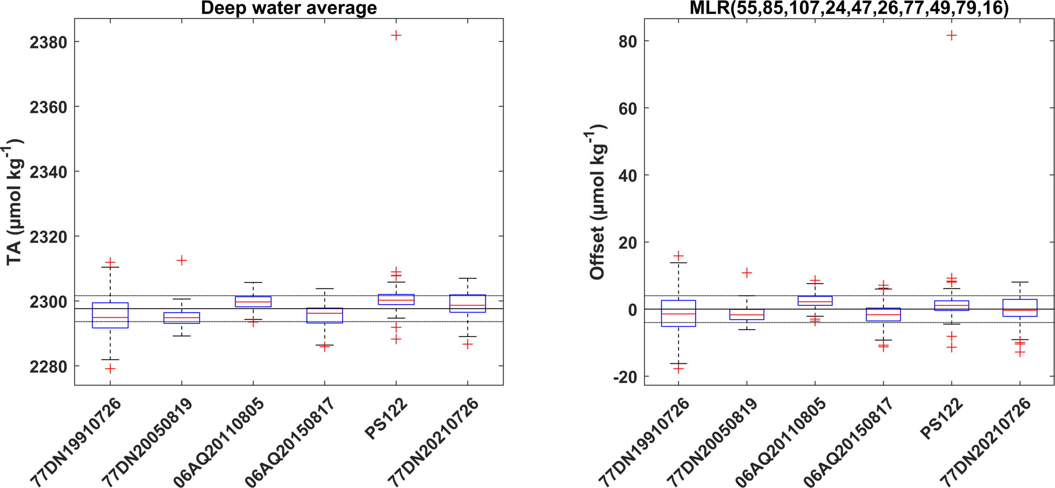
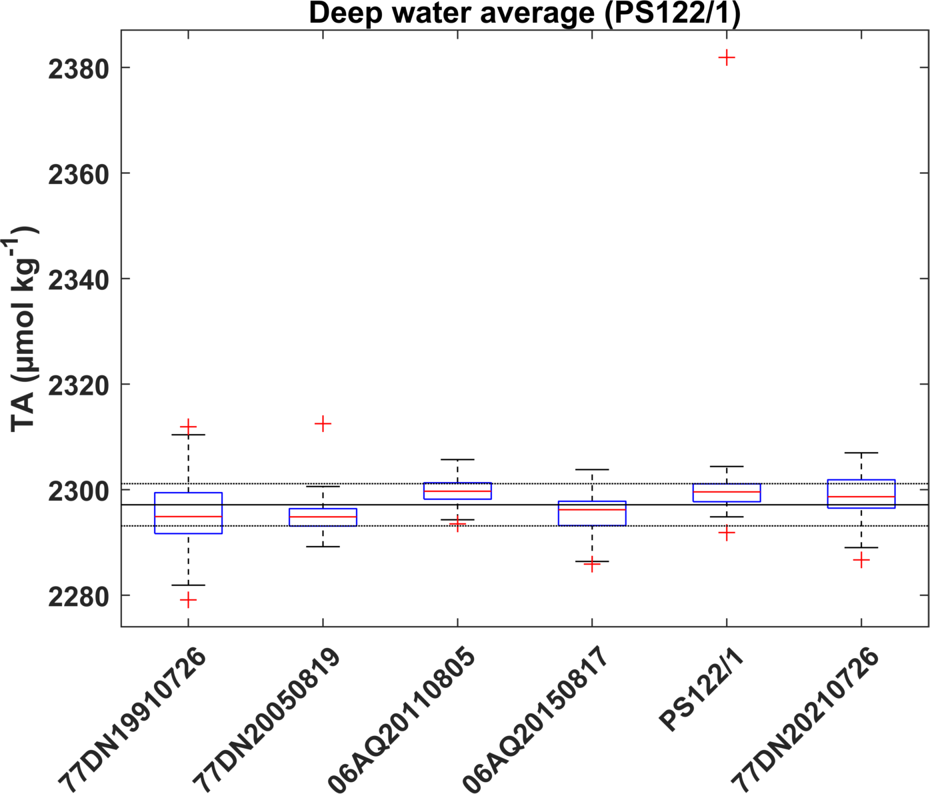
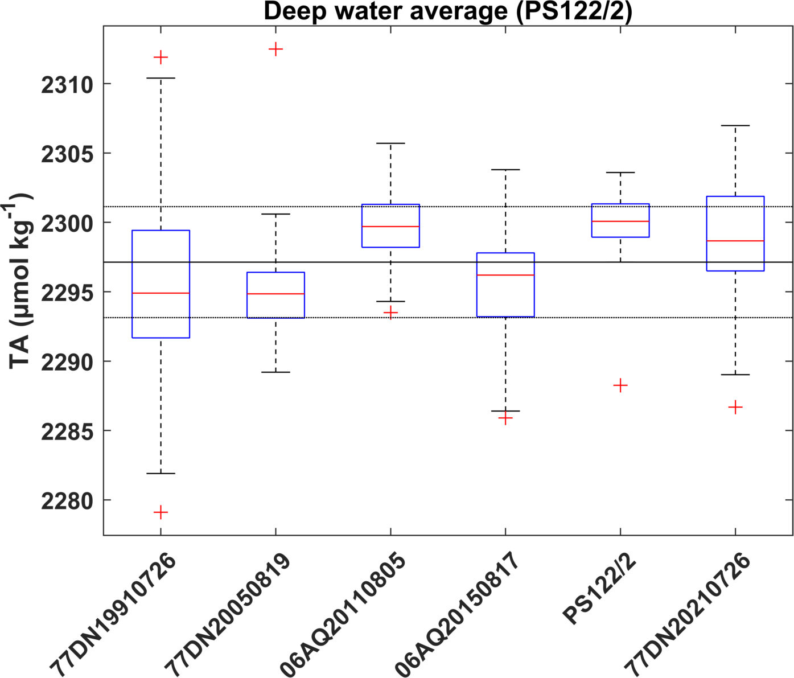
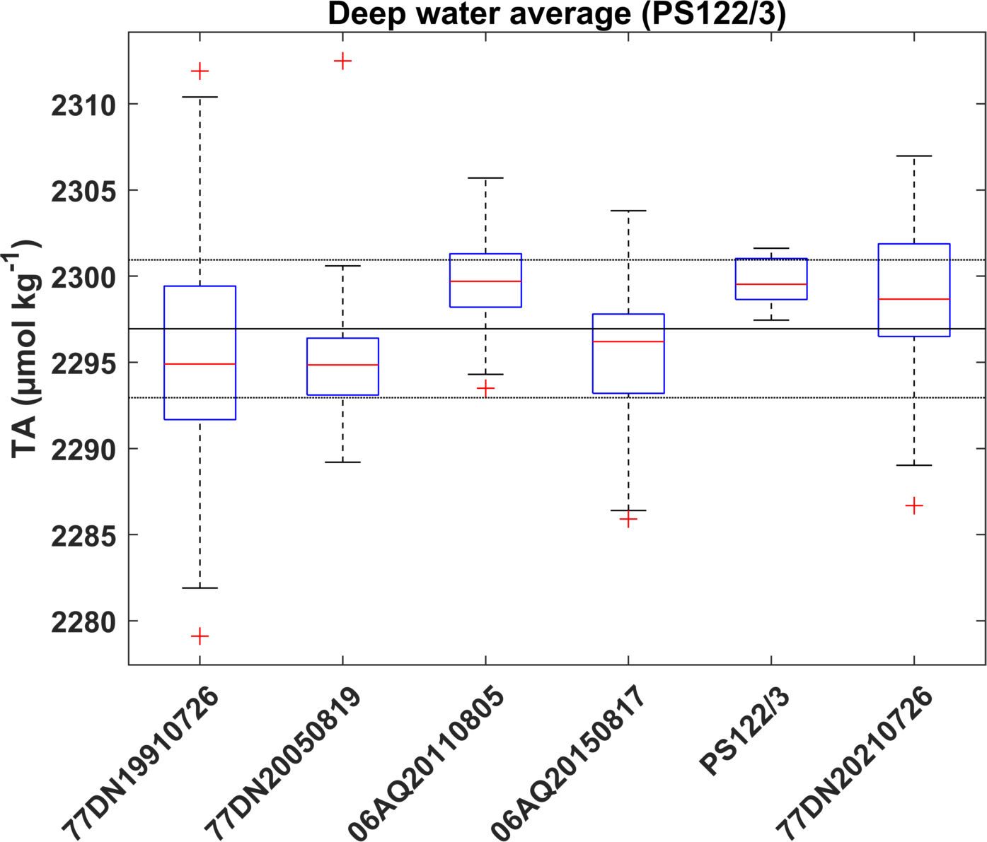
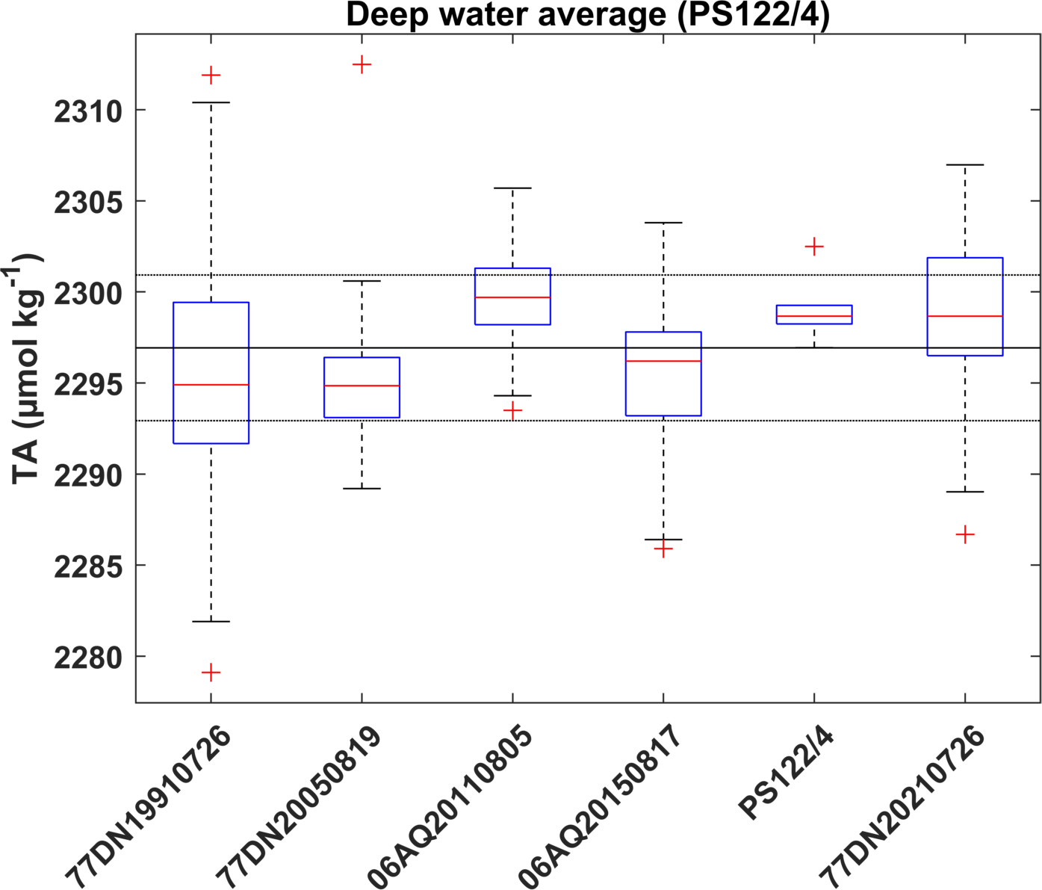
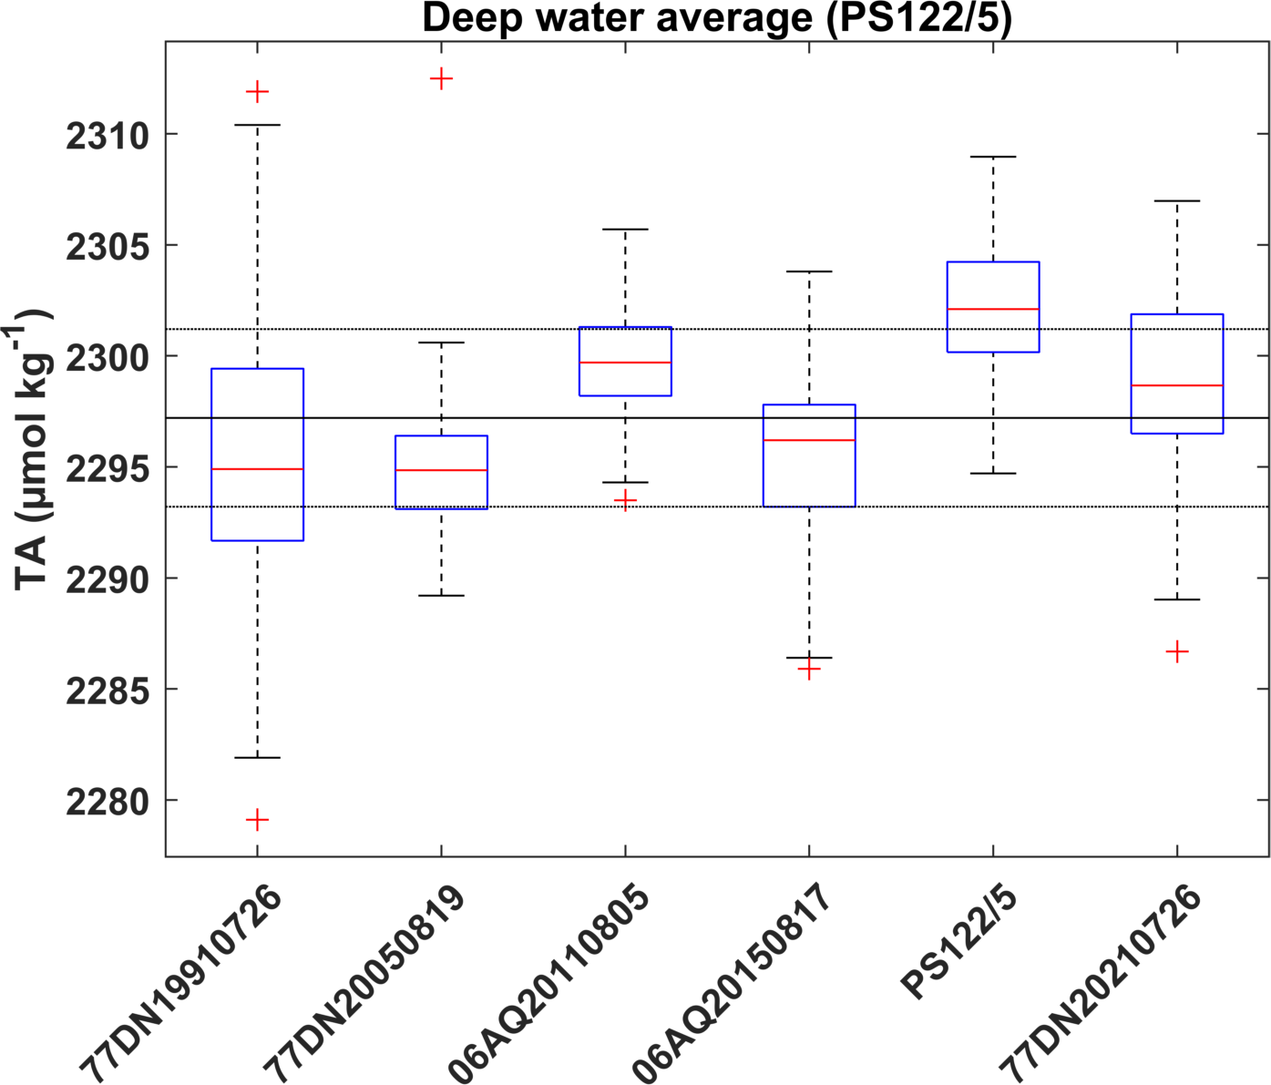
Deep water averages & MLR offset analysis (> 2500 m)

Slide 7
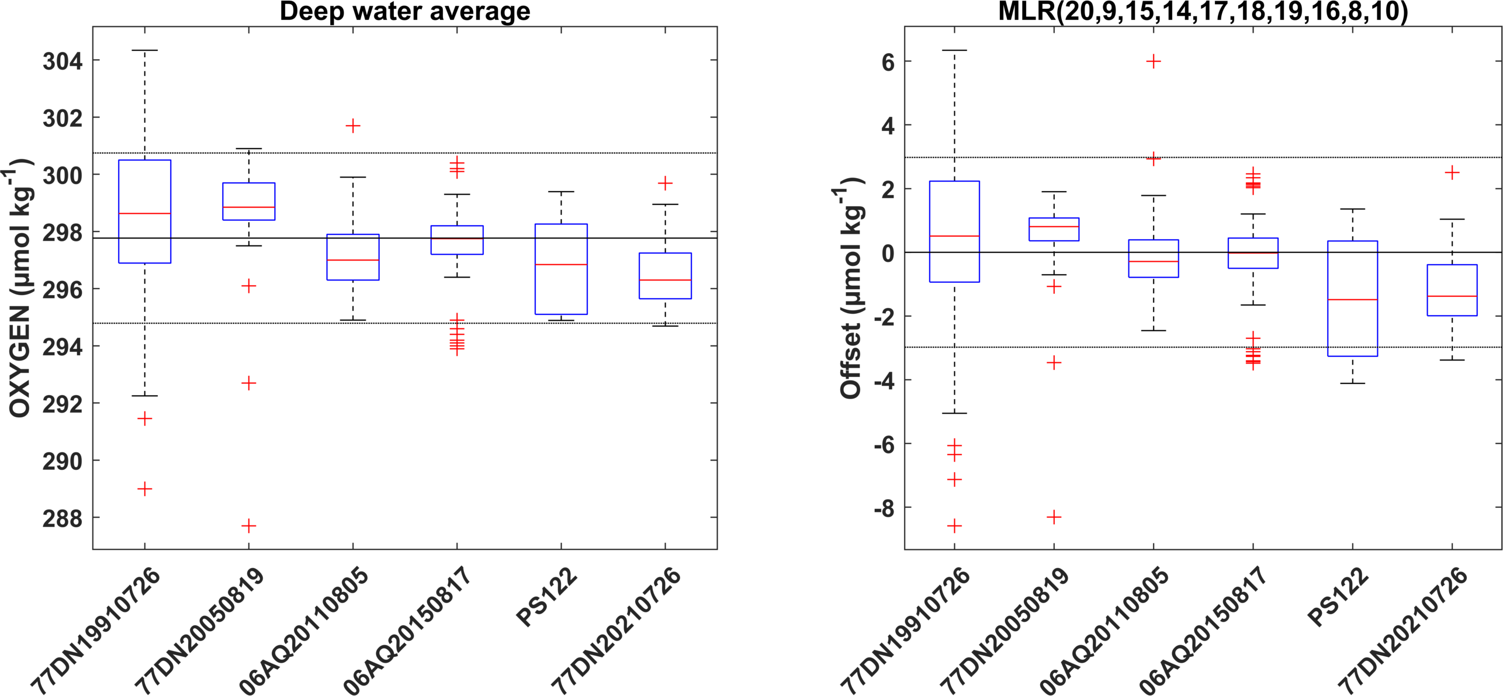
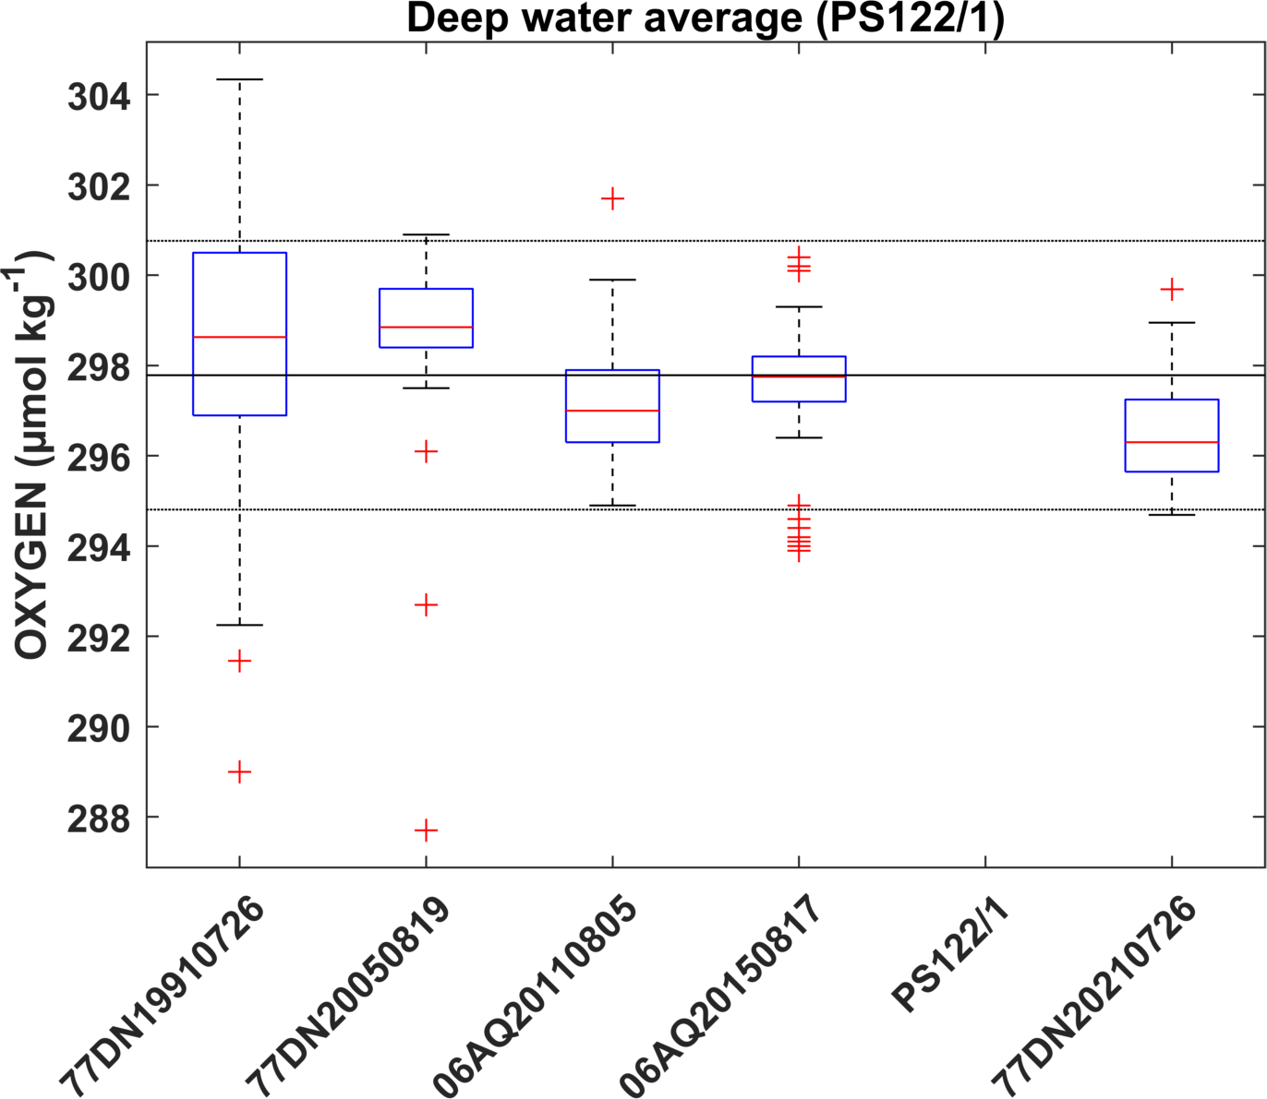
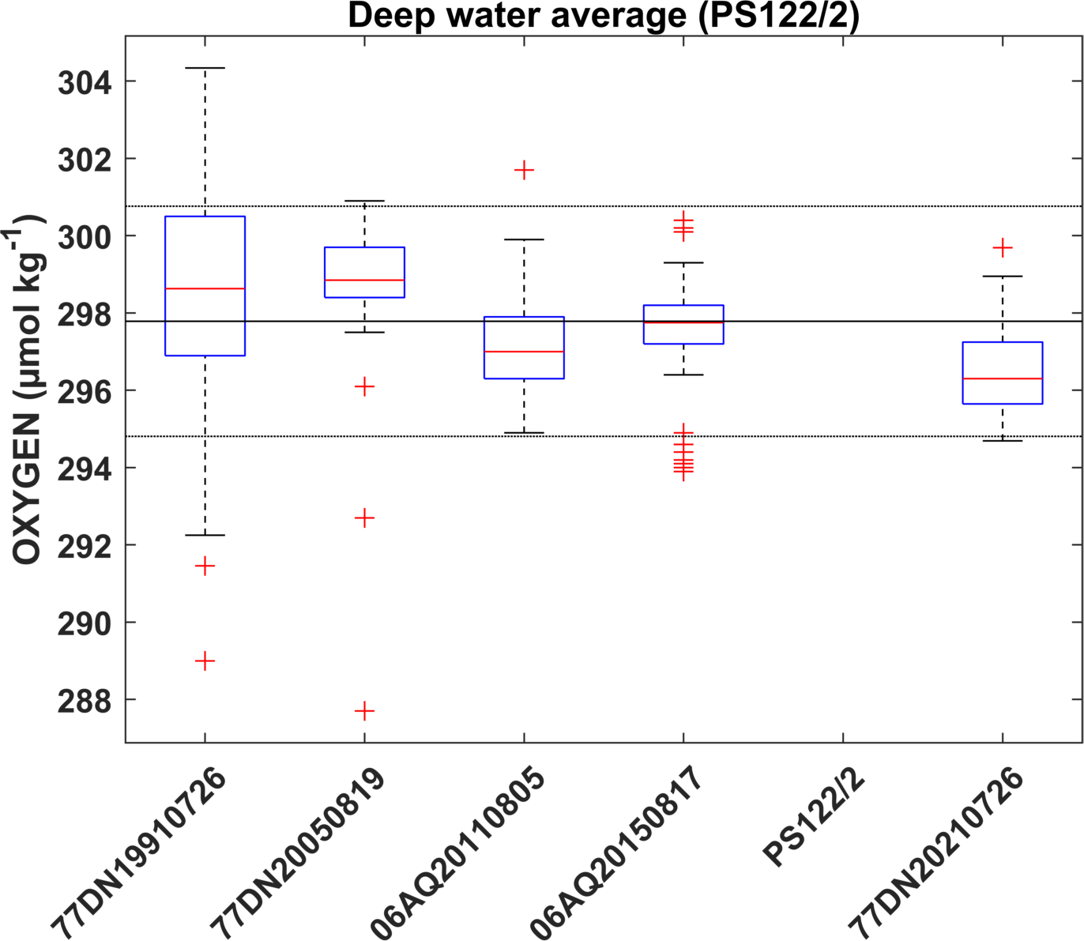
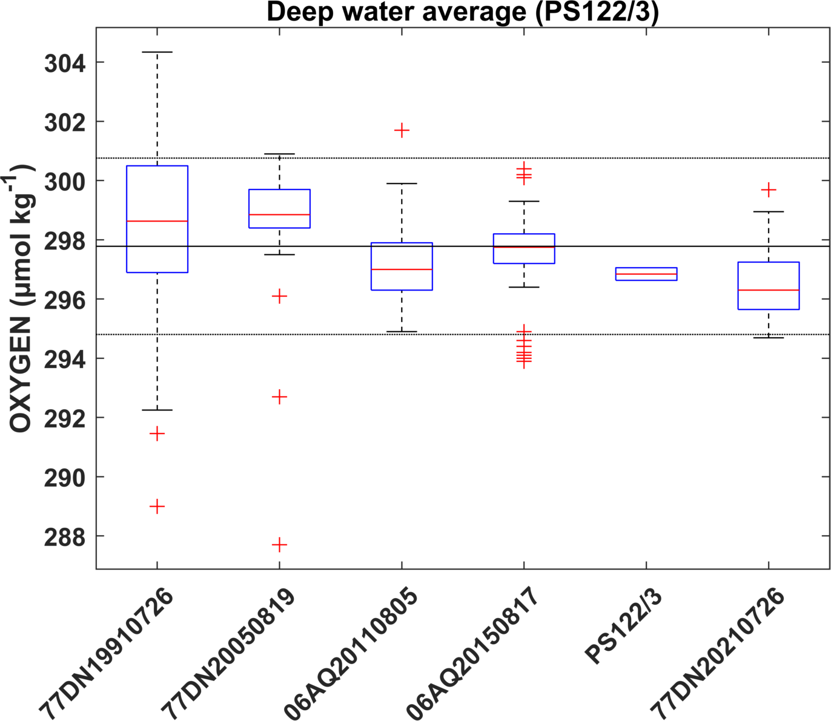
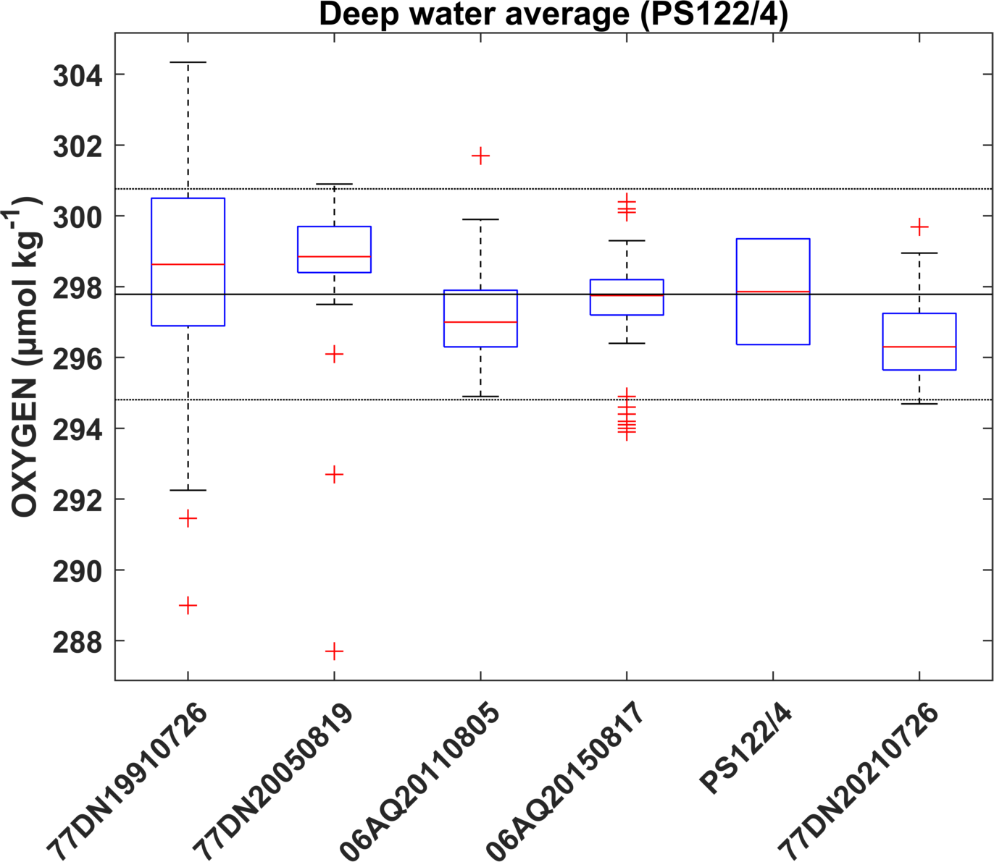
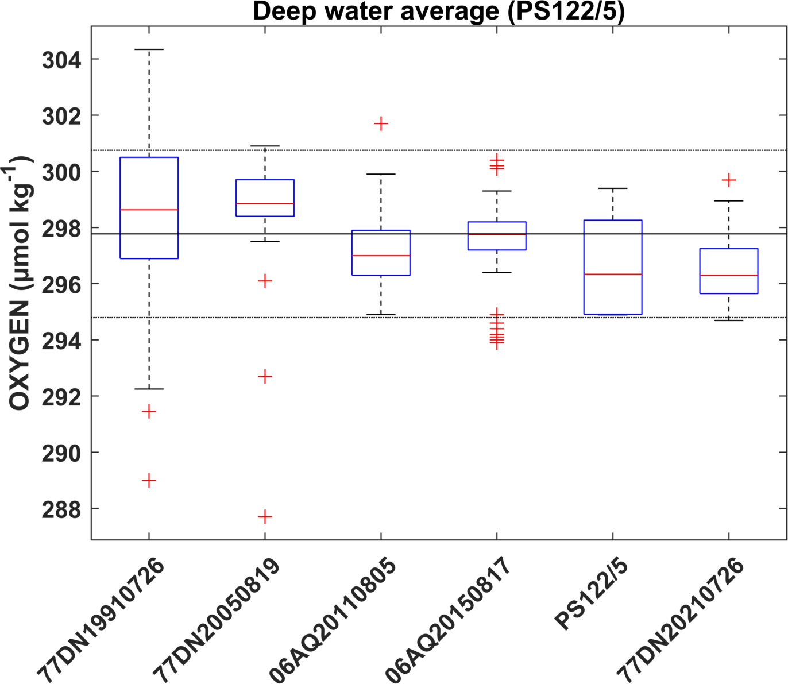
Deep water averages & MLR offset analysis (> 2500 m)

Slide 8
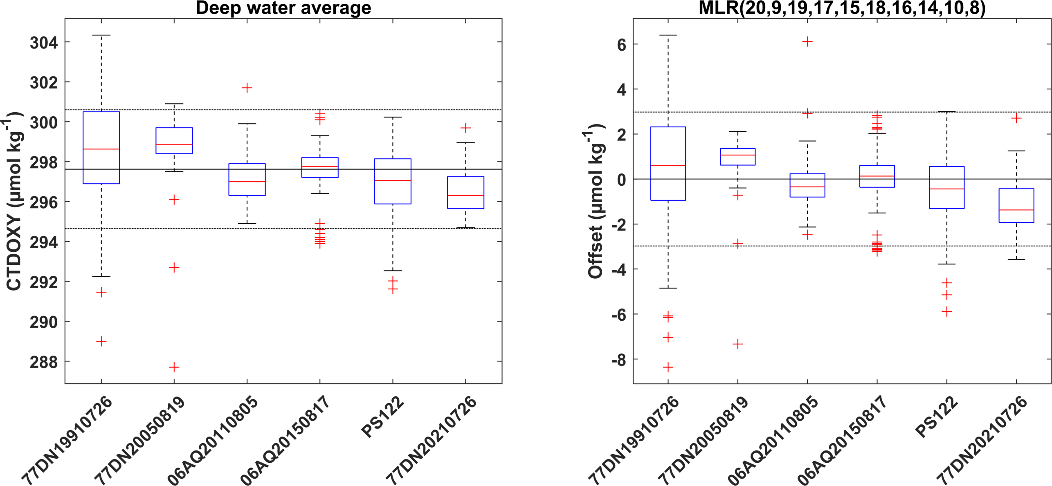
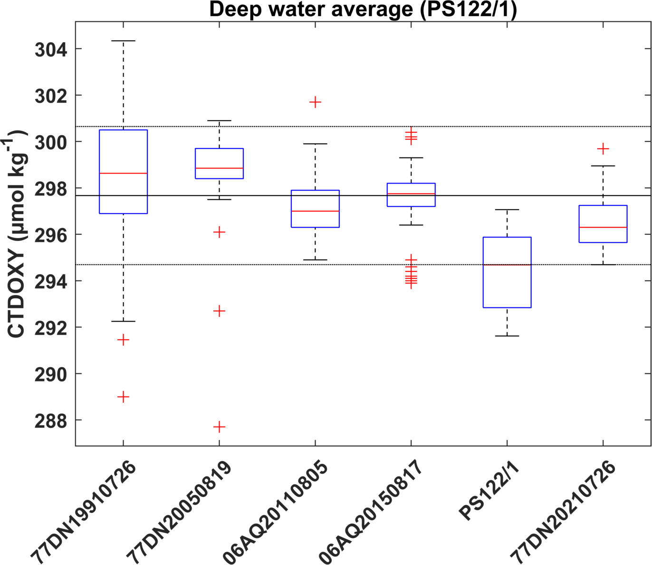

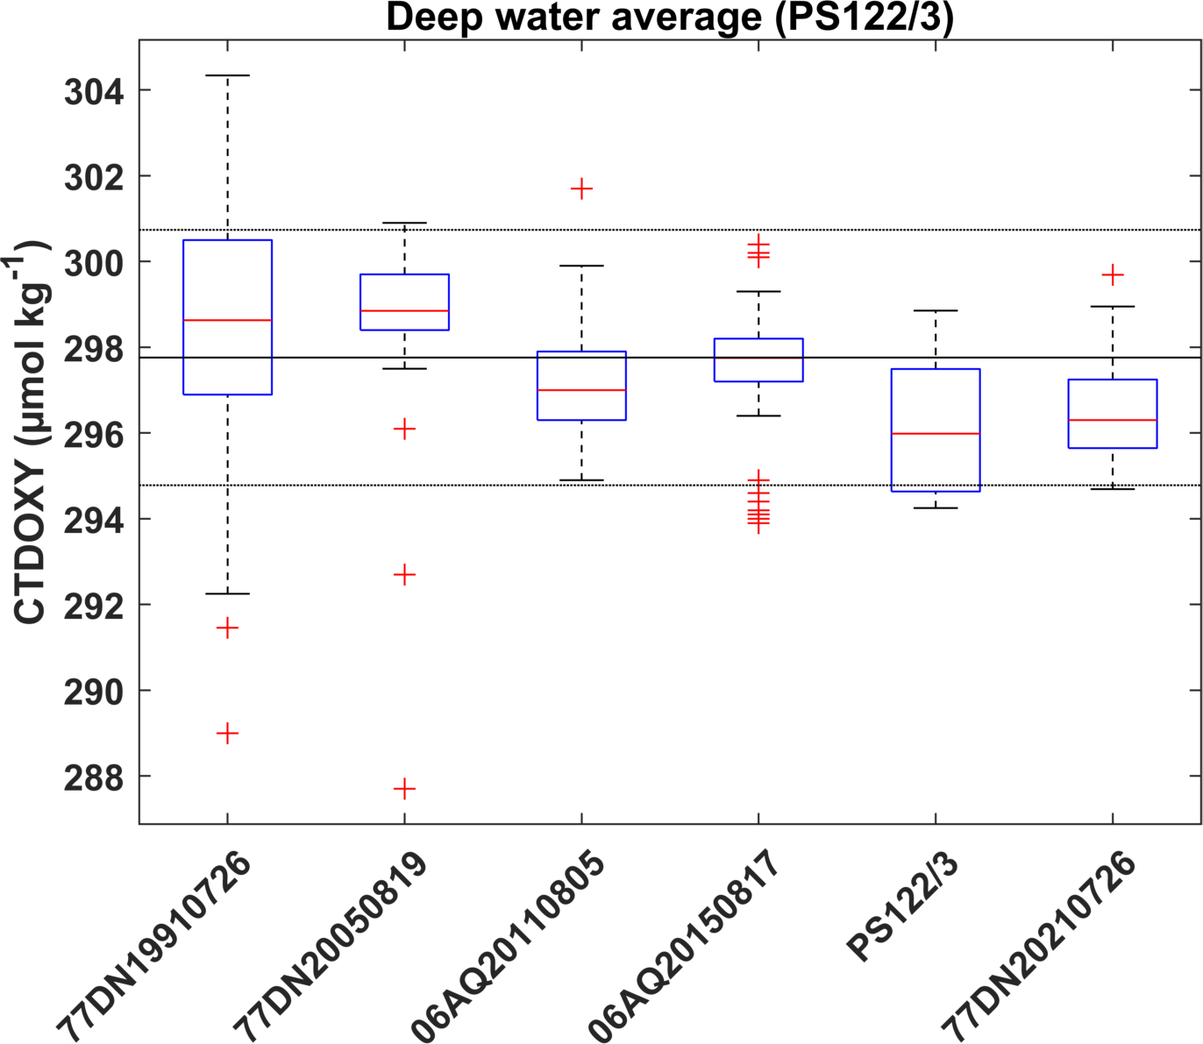
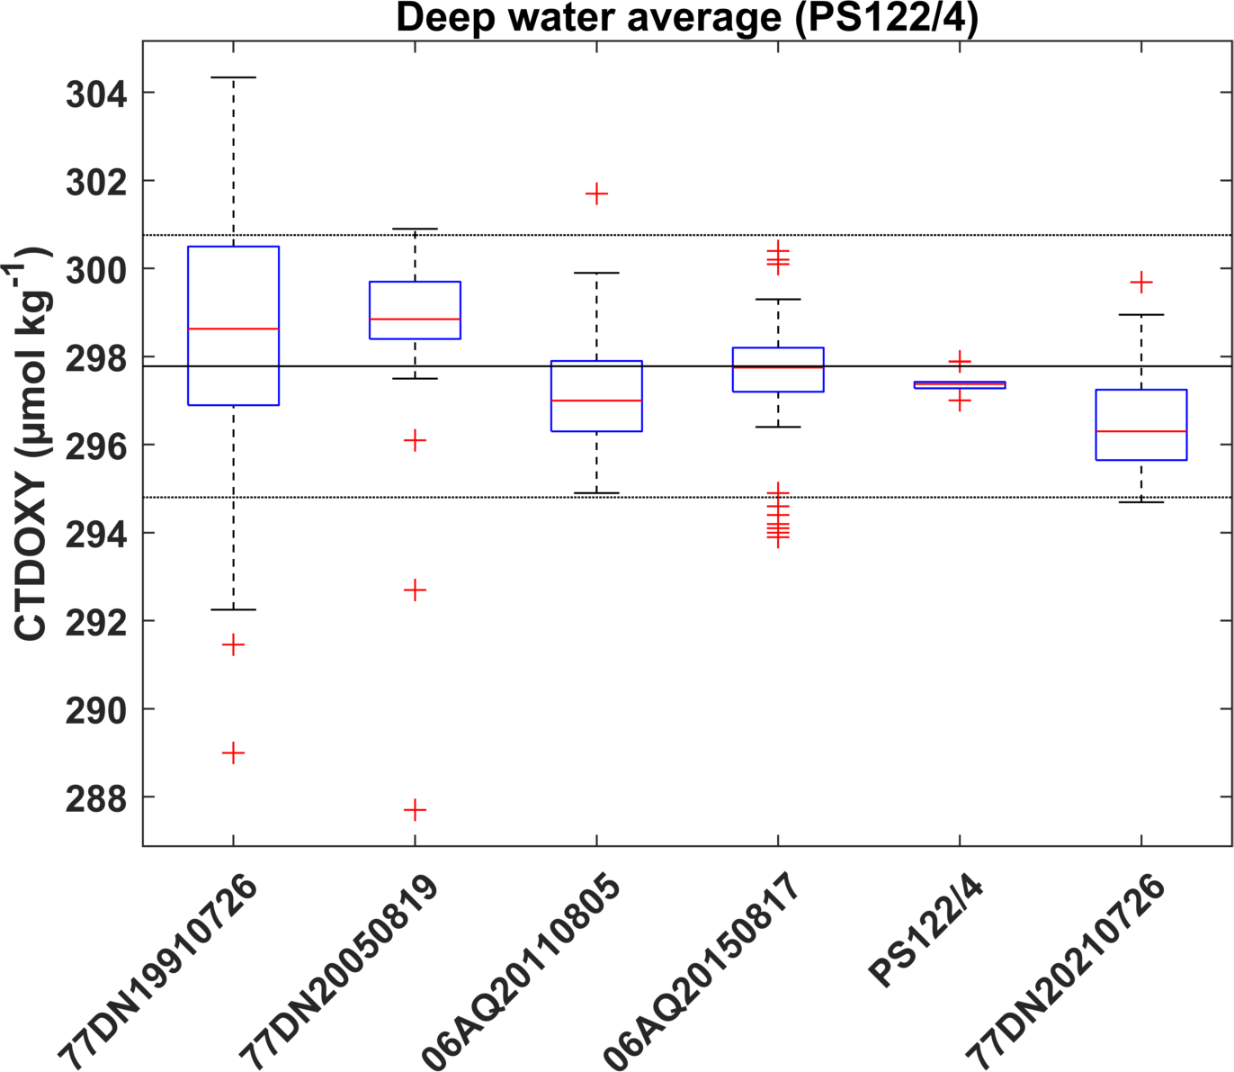
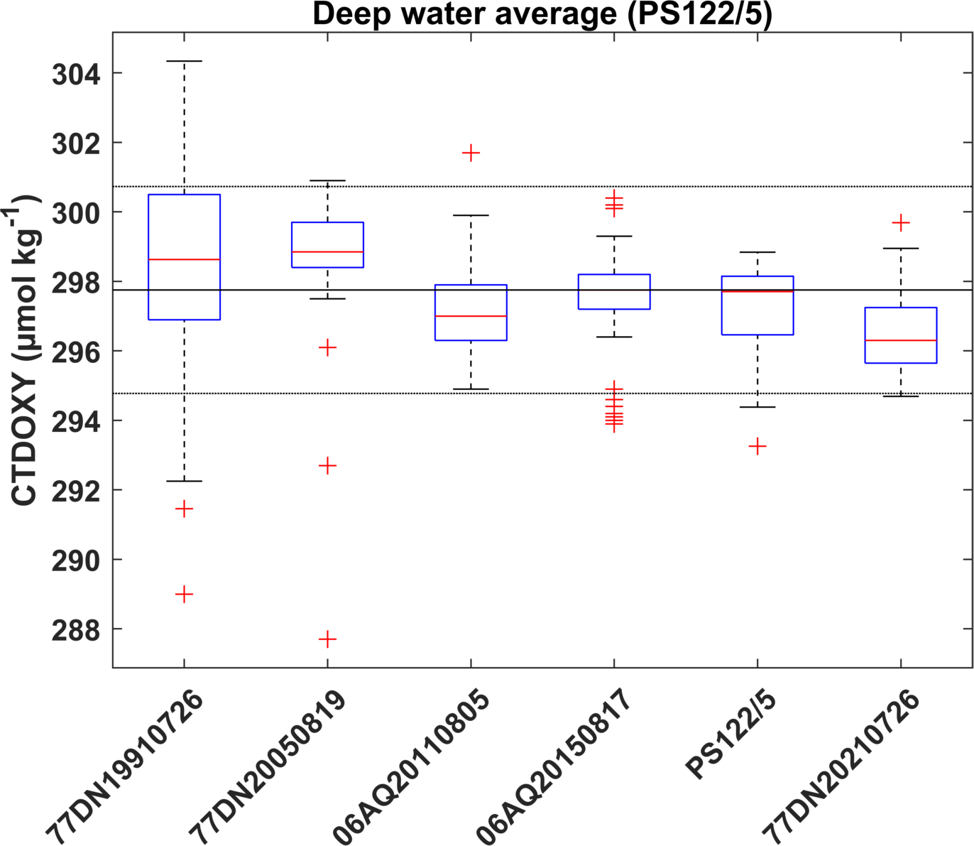
Deep water averages & MLR offset analysis (> 2500 m)

Slide 9
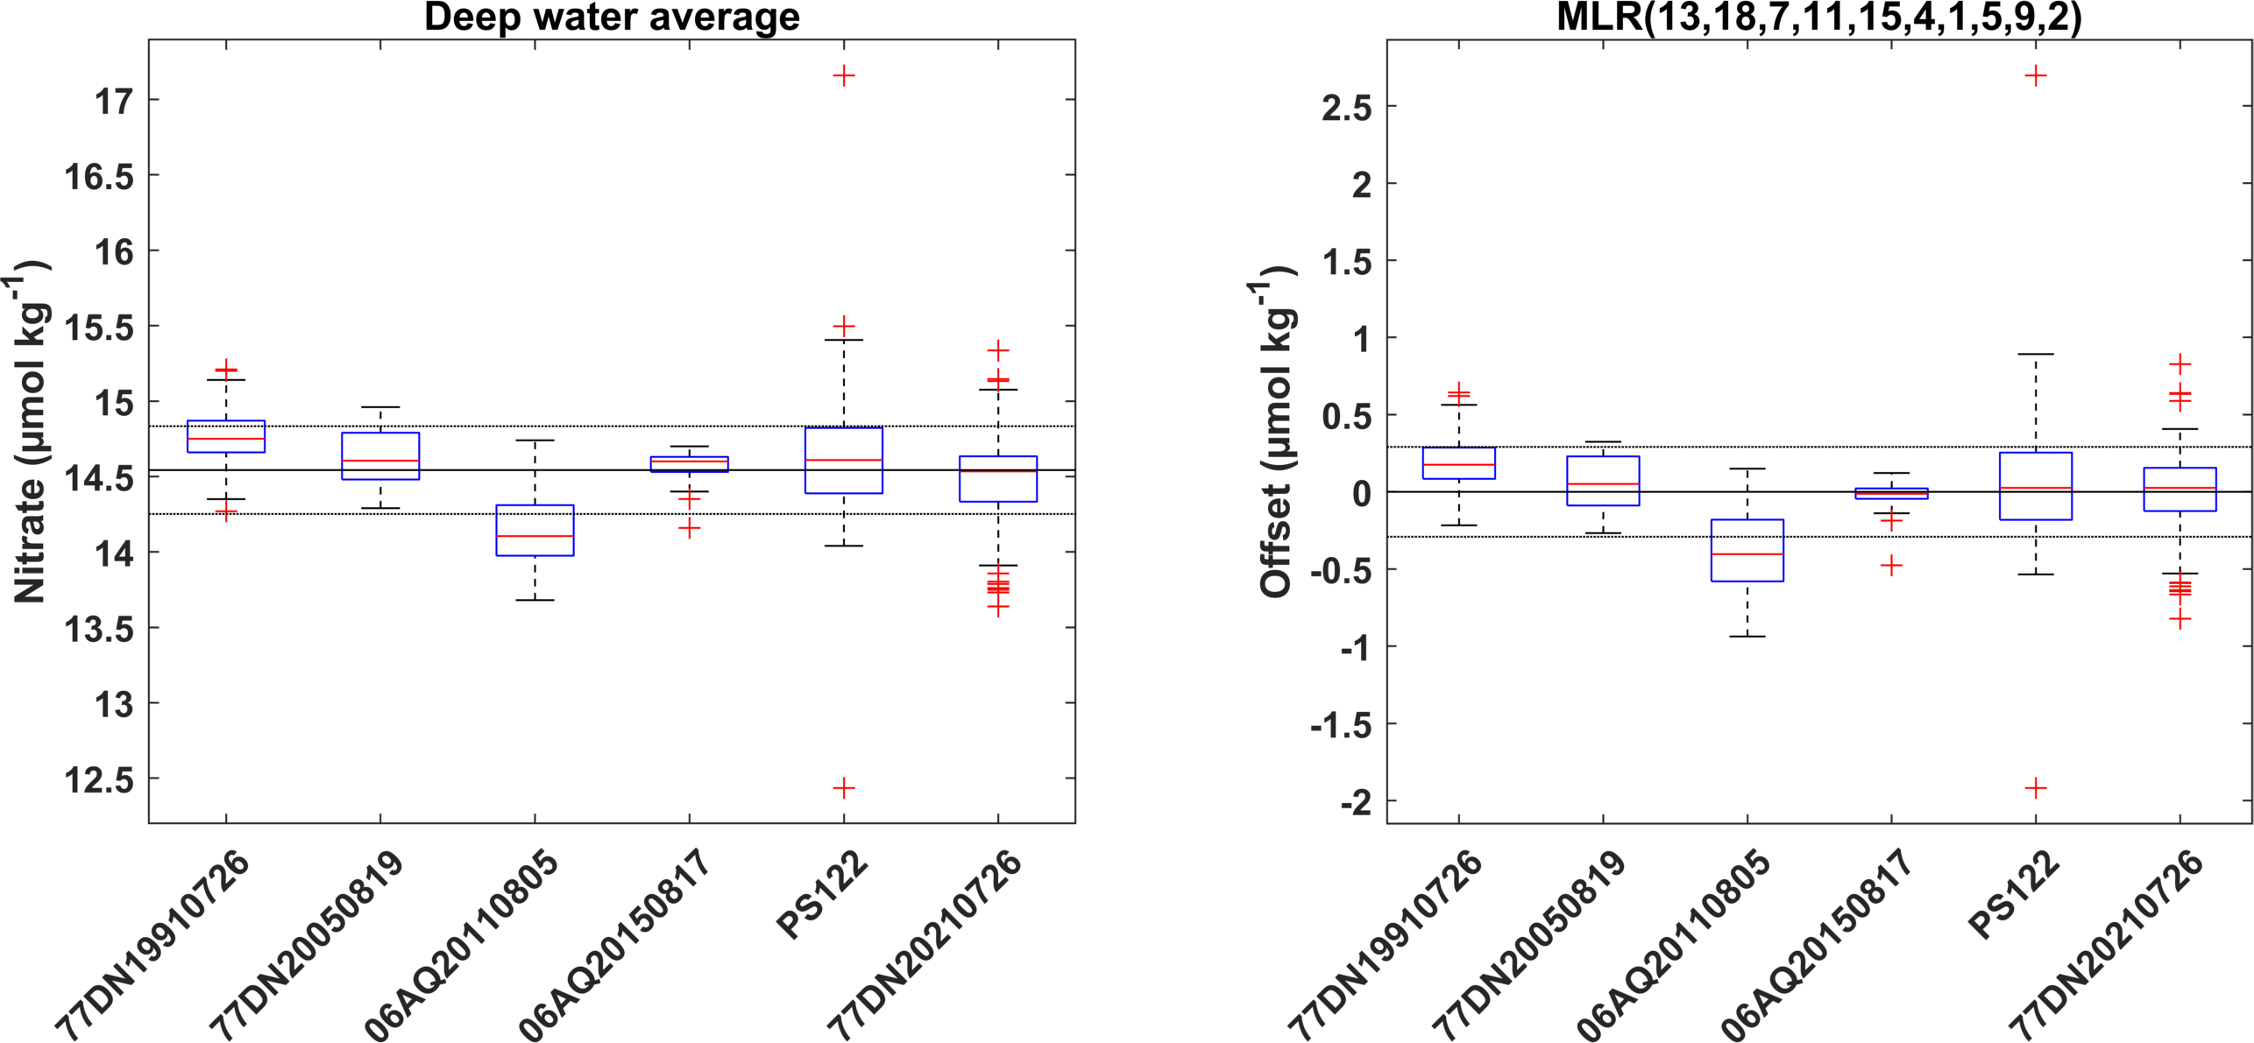
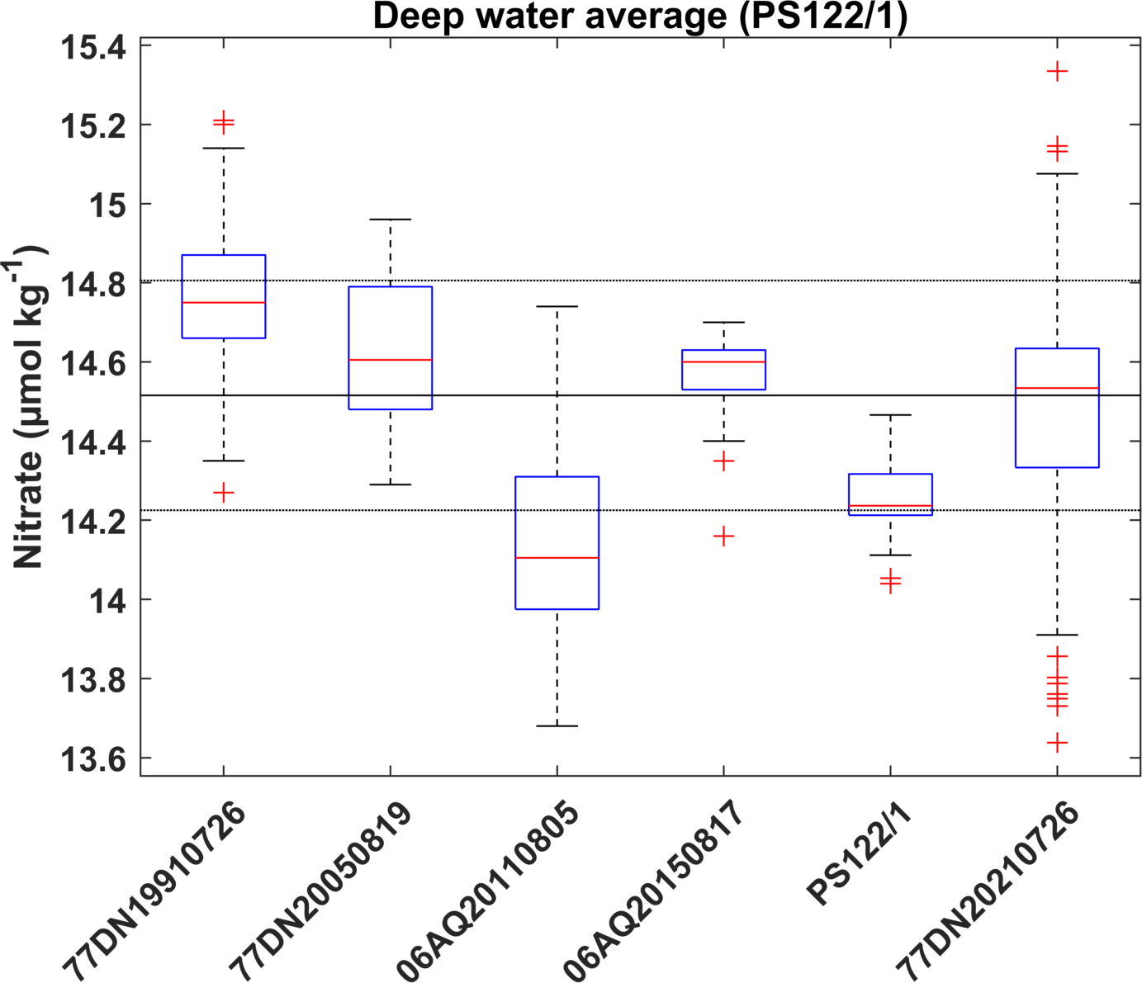
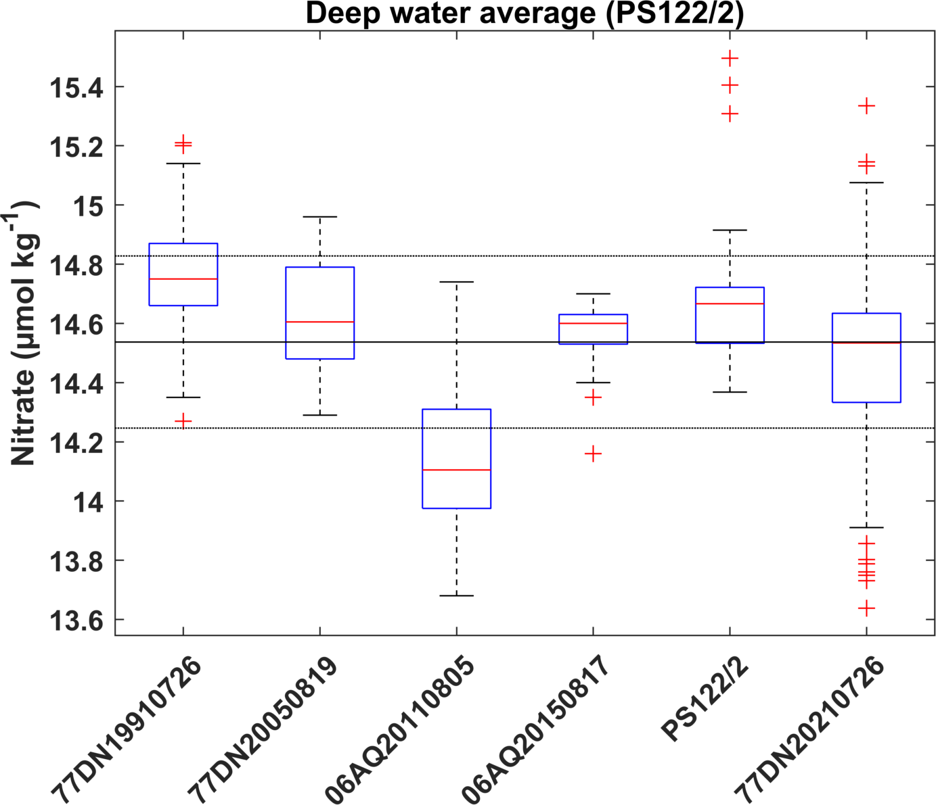
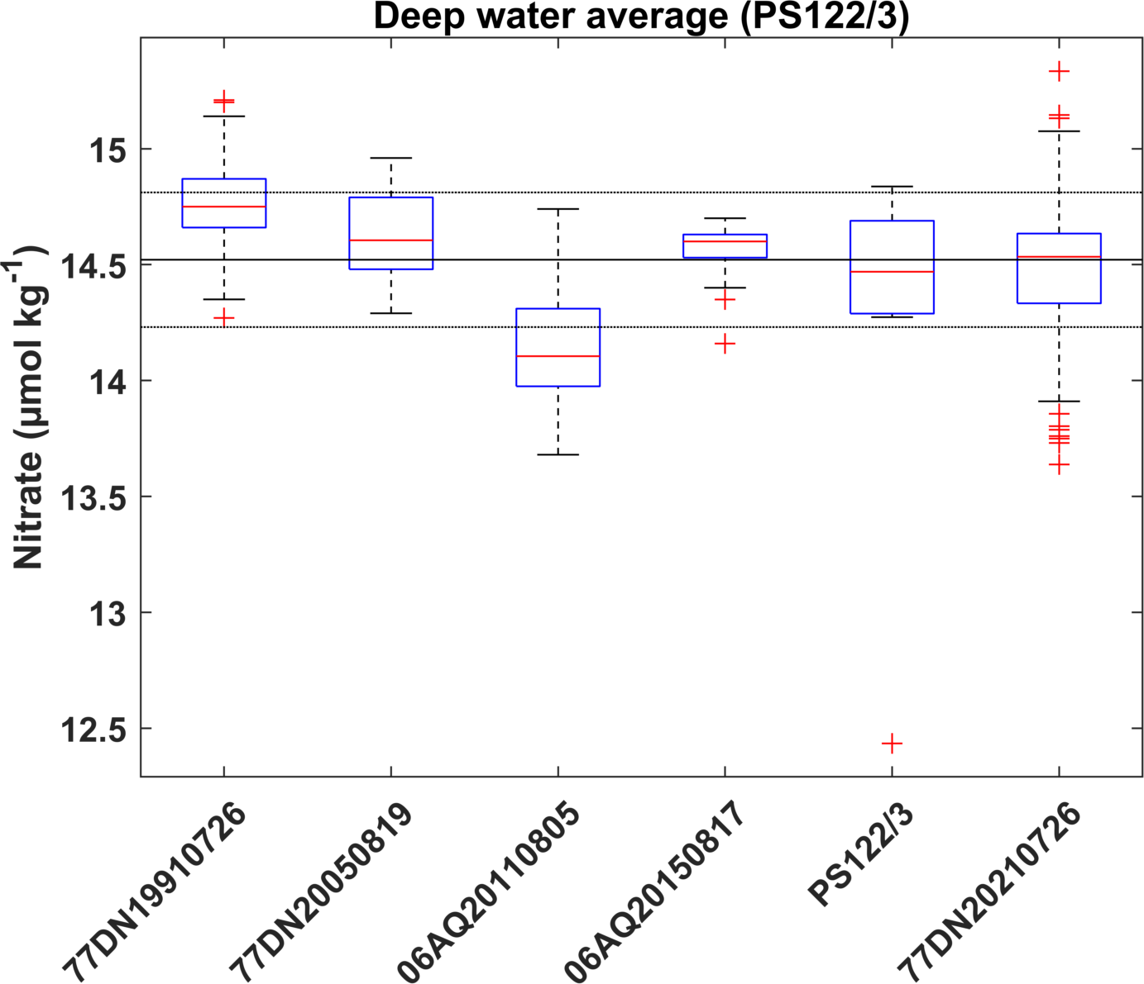
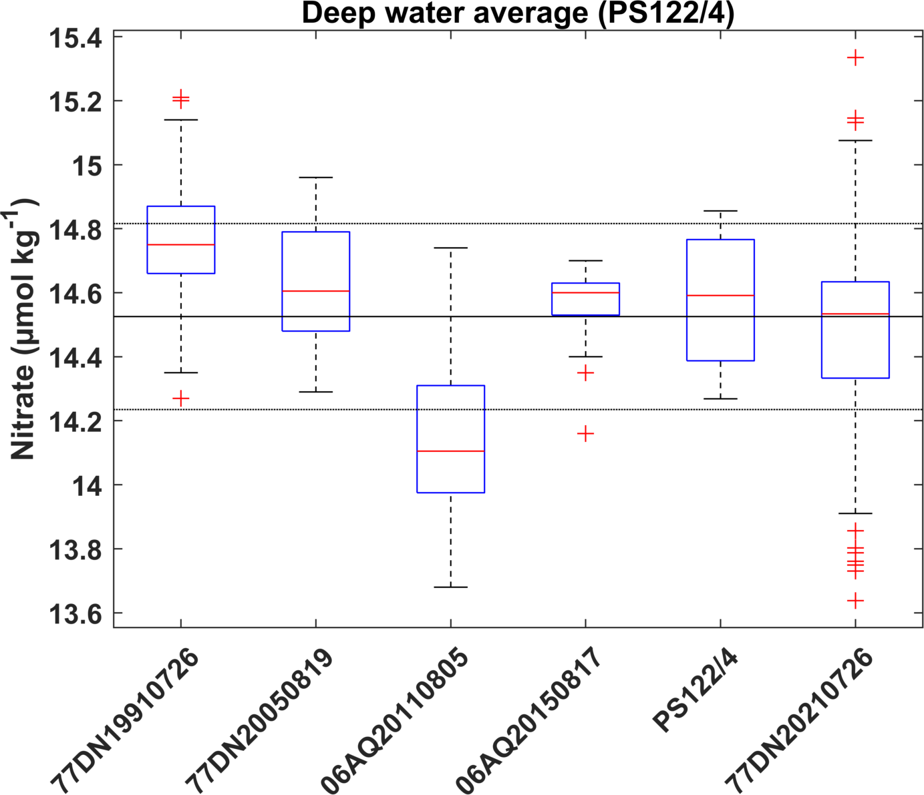
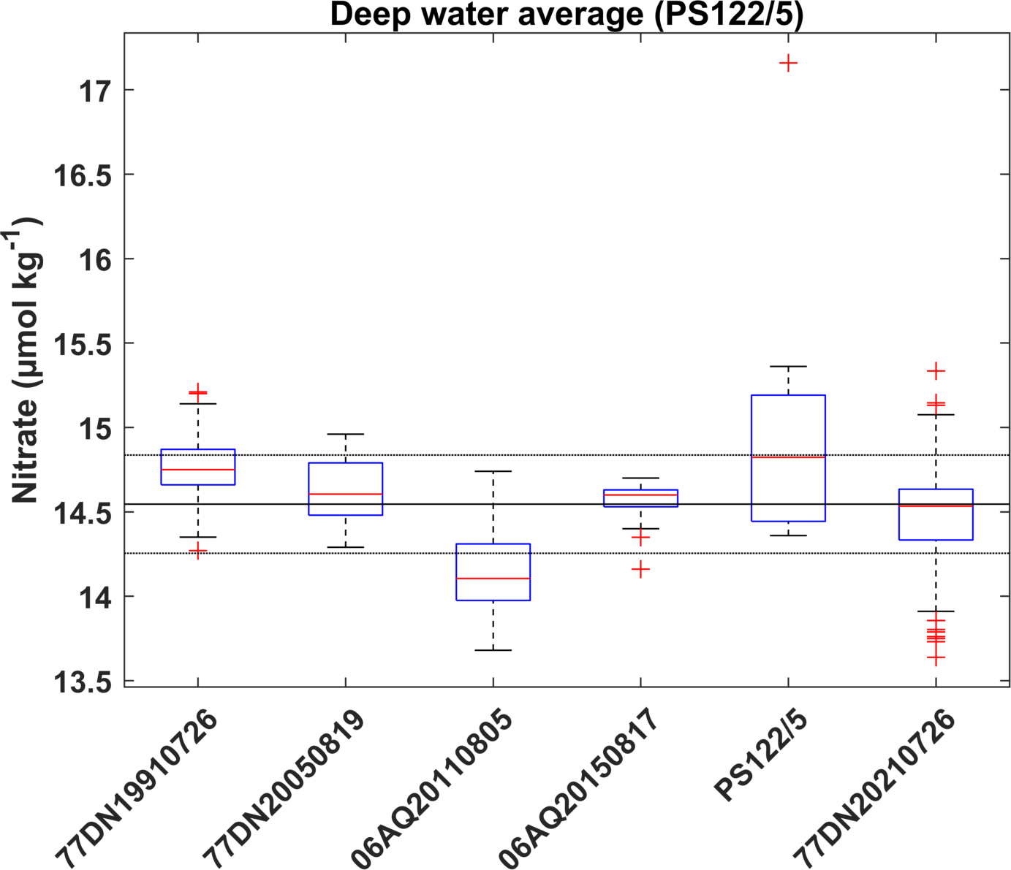
Deep water averages & MLR offset analysis (> 2500 m)

Slide 10
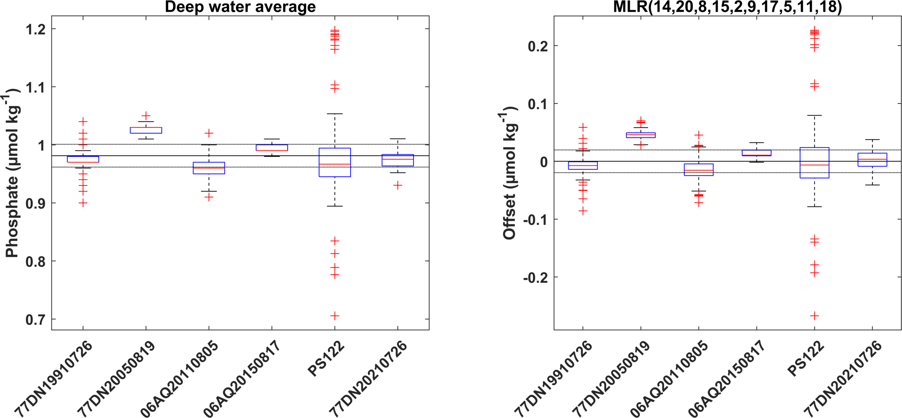
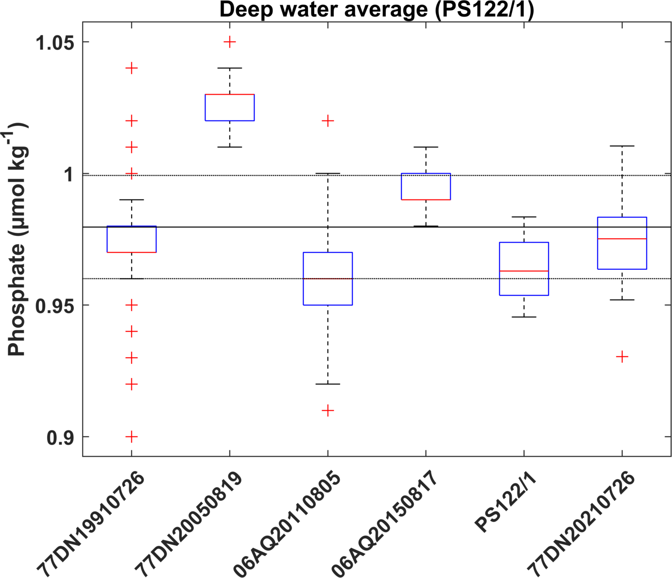
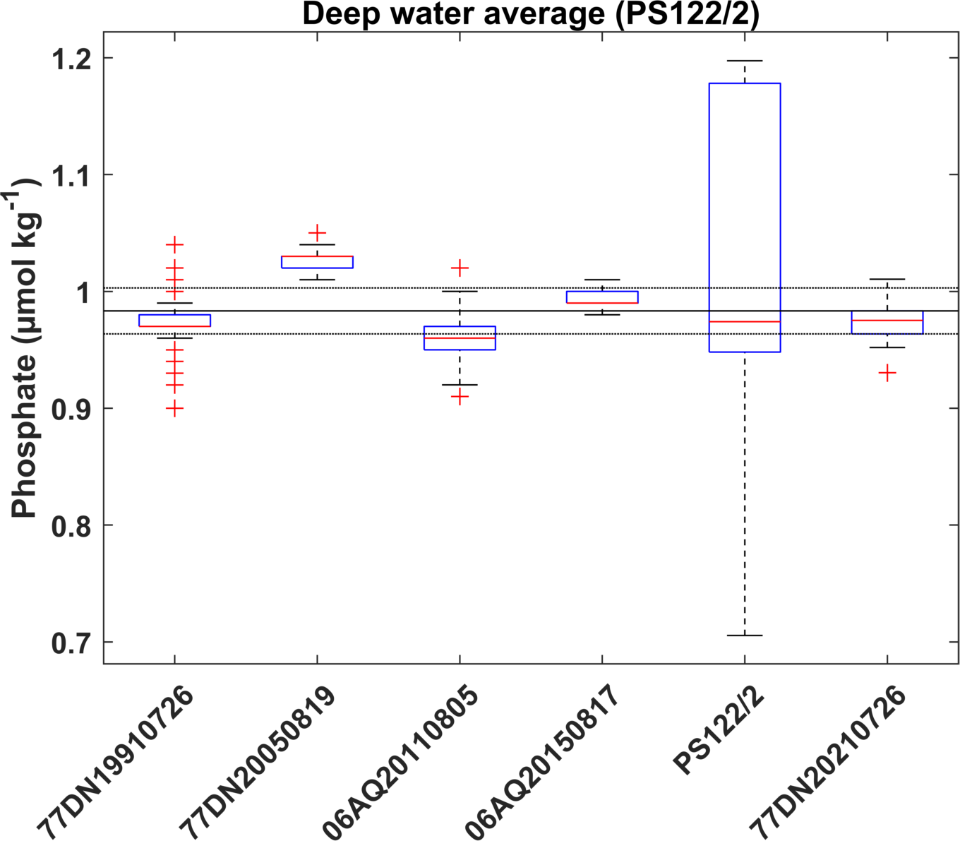
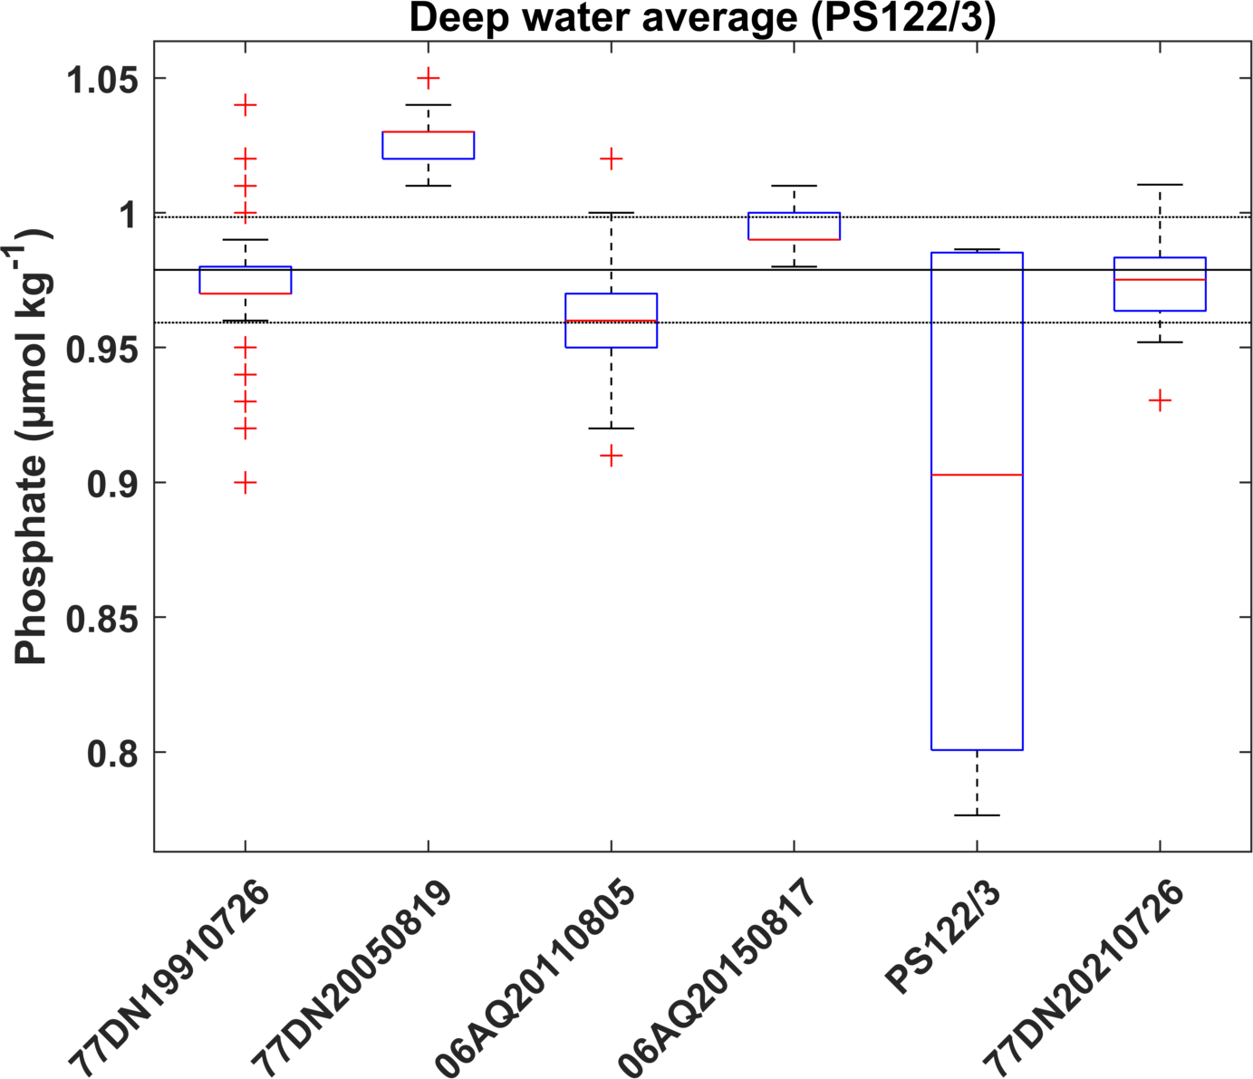
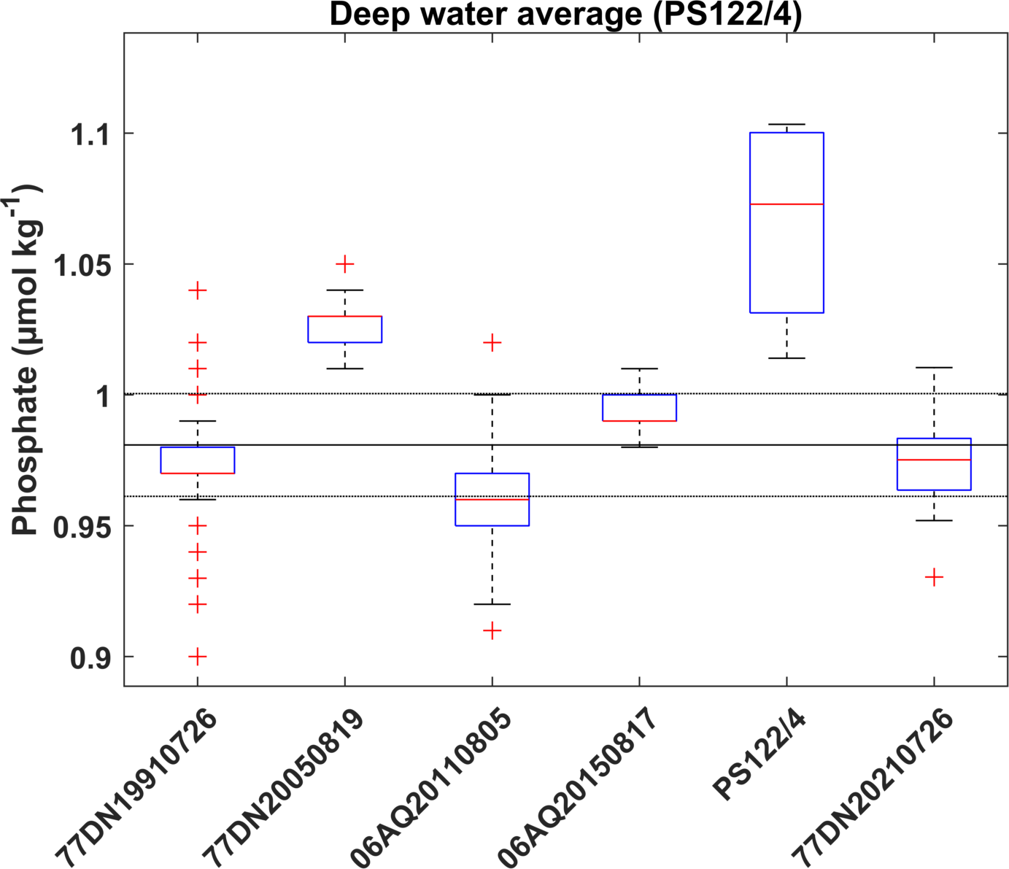
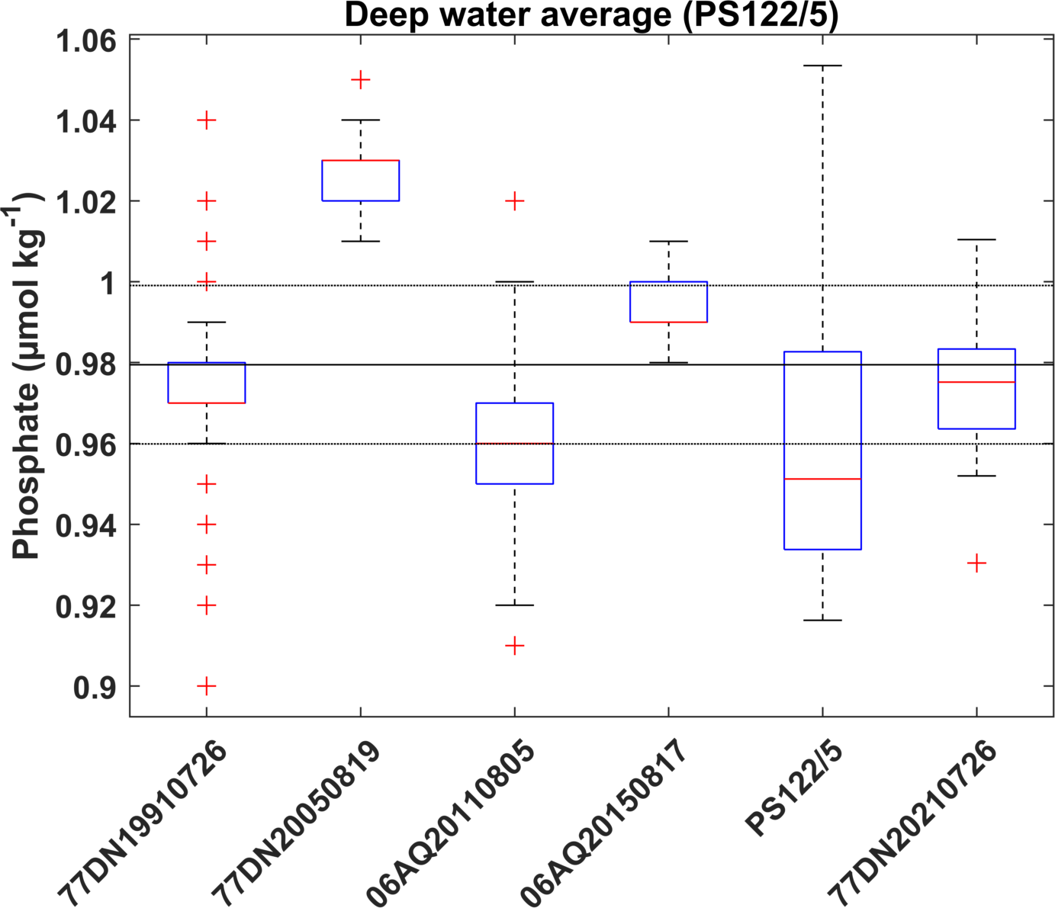
Deep water averages & MLR offset analysis (> 2500 m)

Slide 11
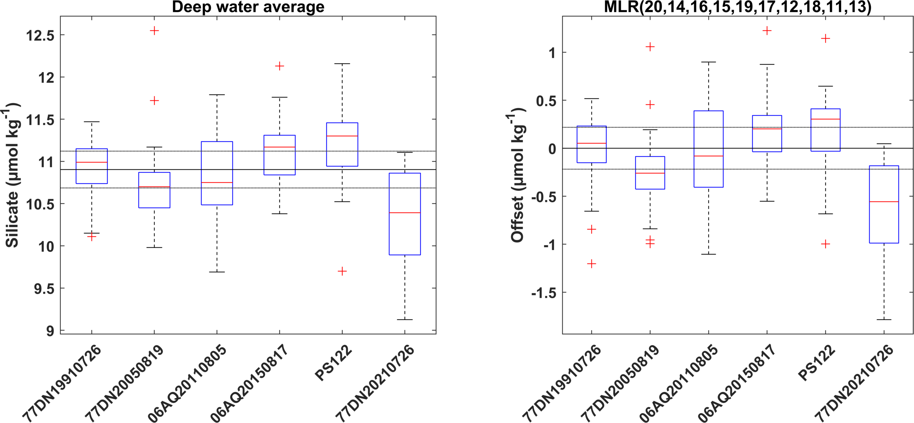
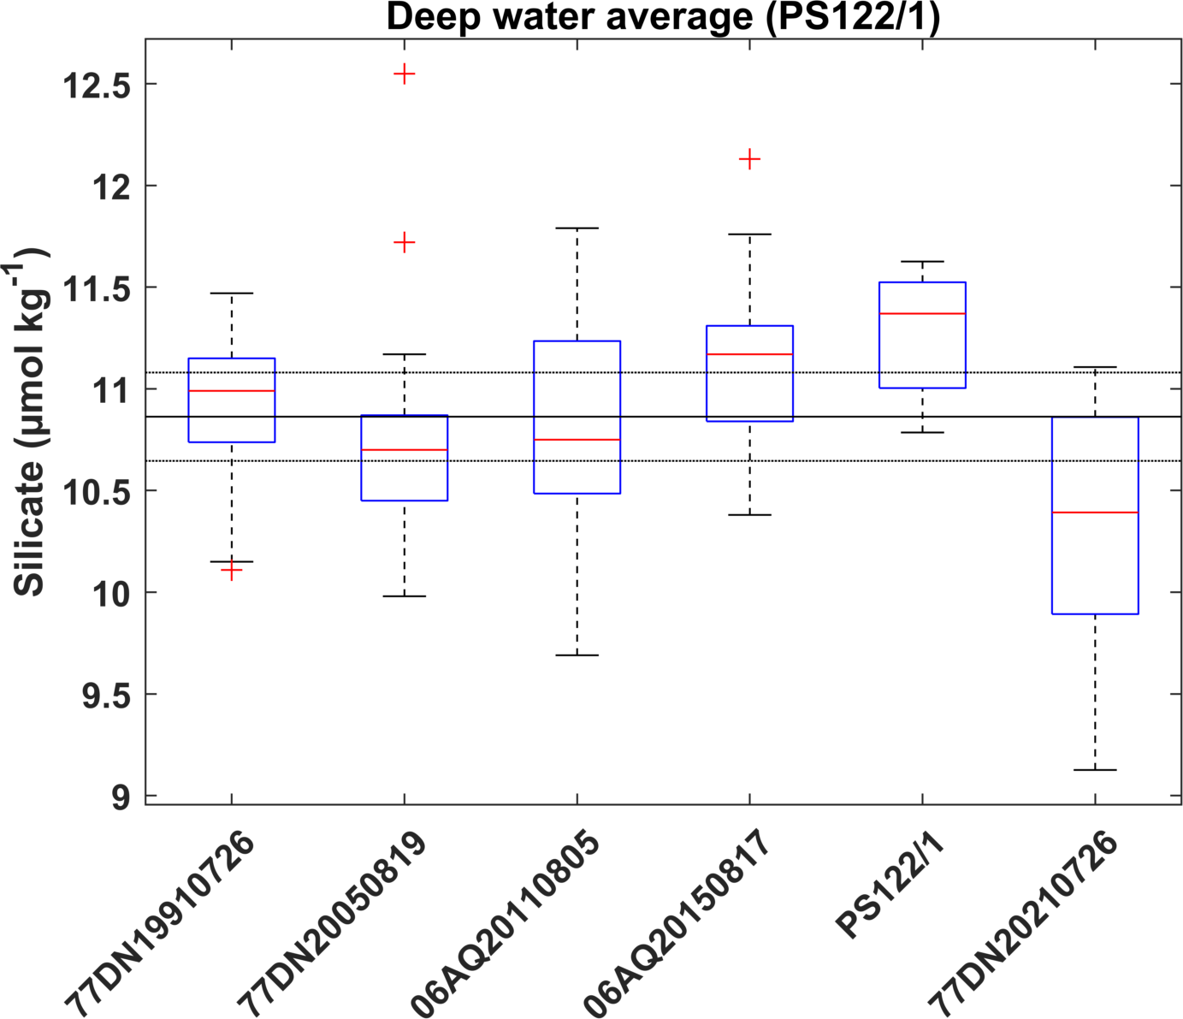


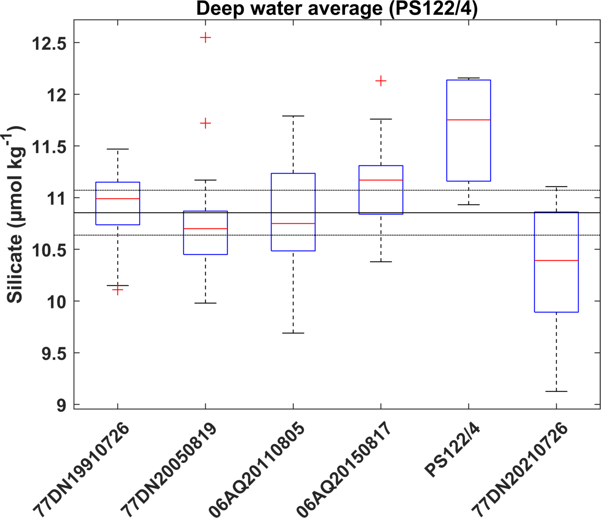

Deep water averages & MLR offset analysis (> 2500 m)

Slide 12
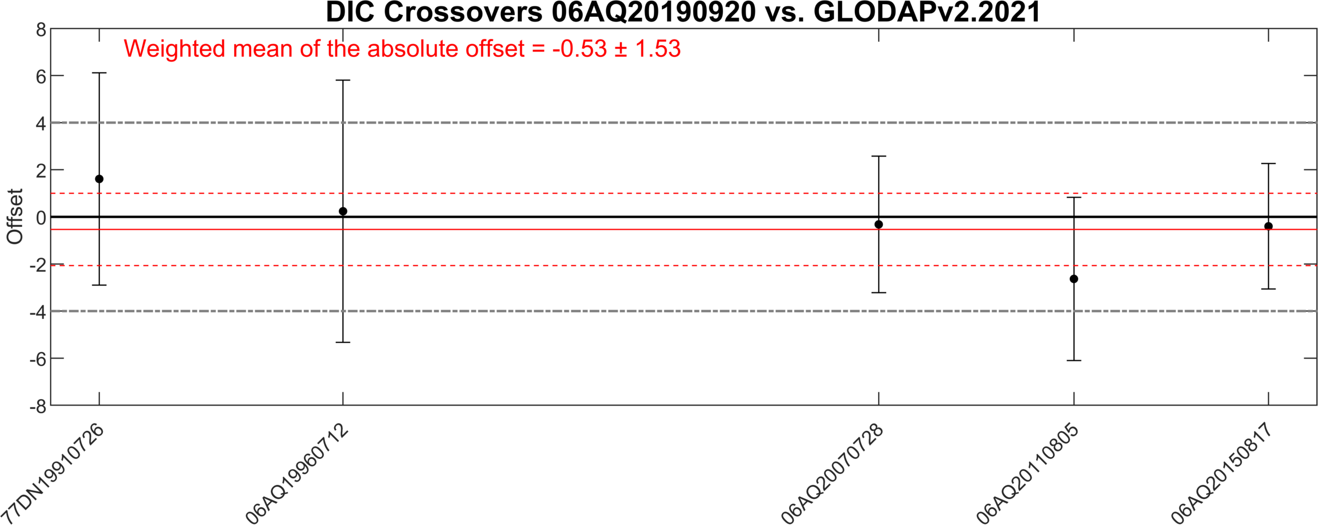
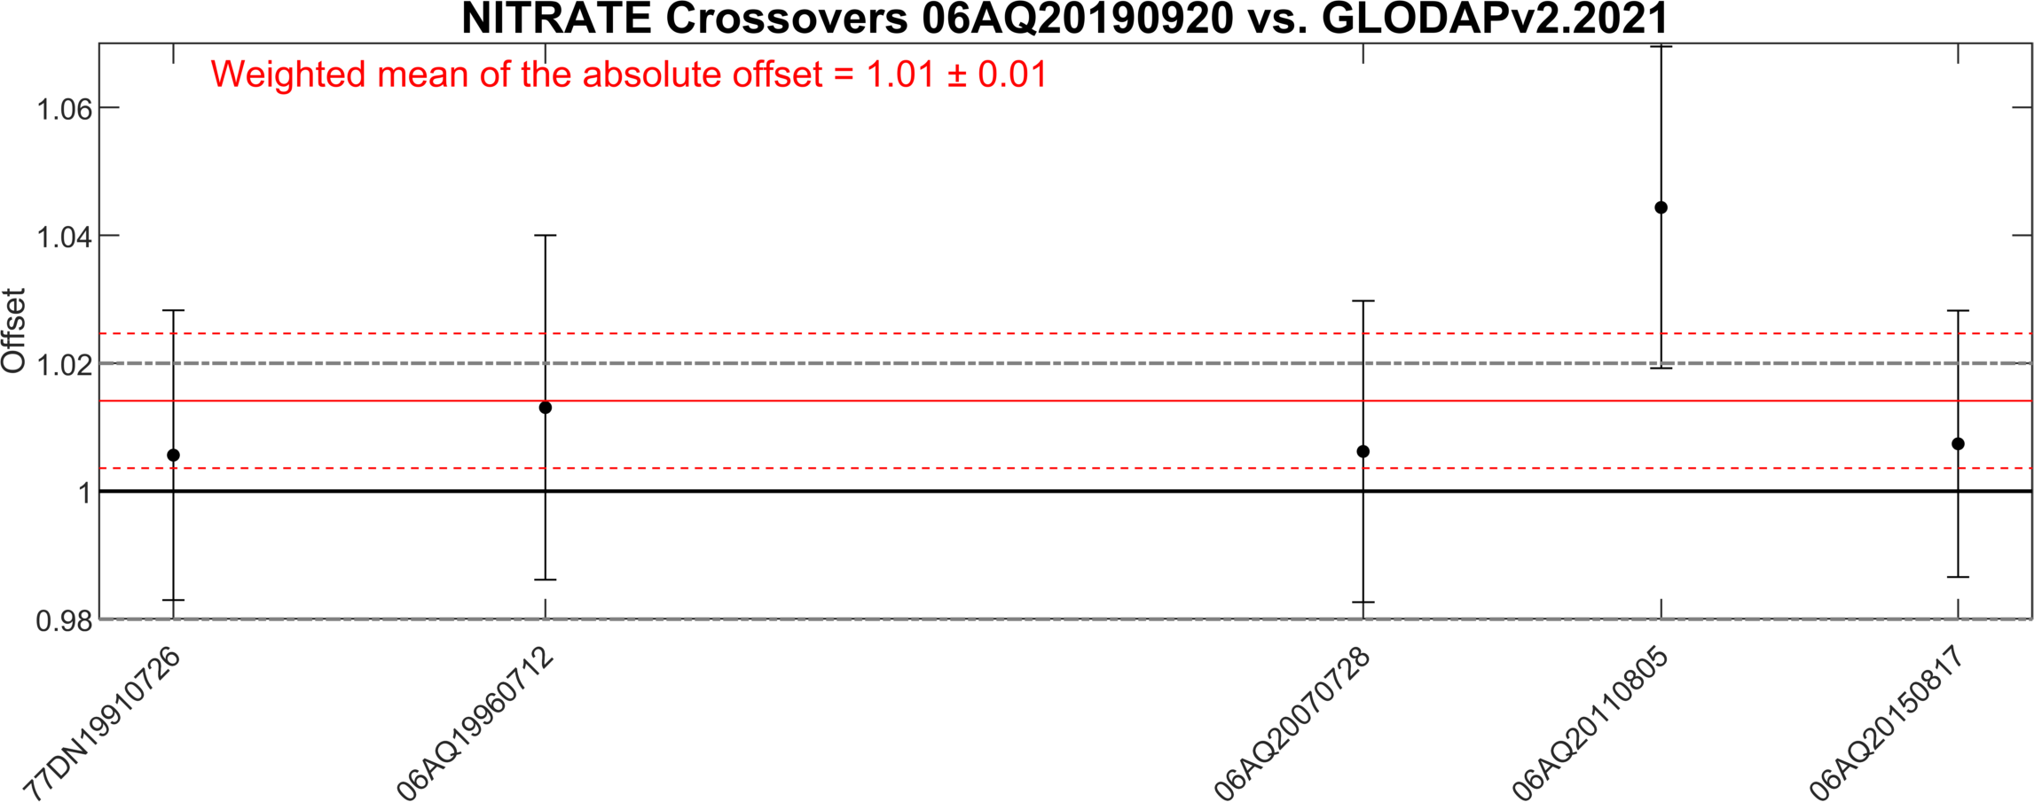
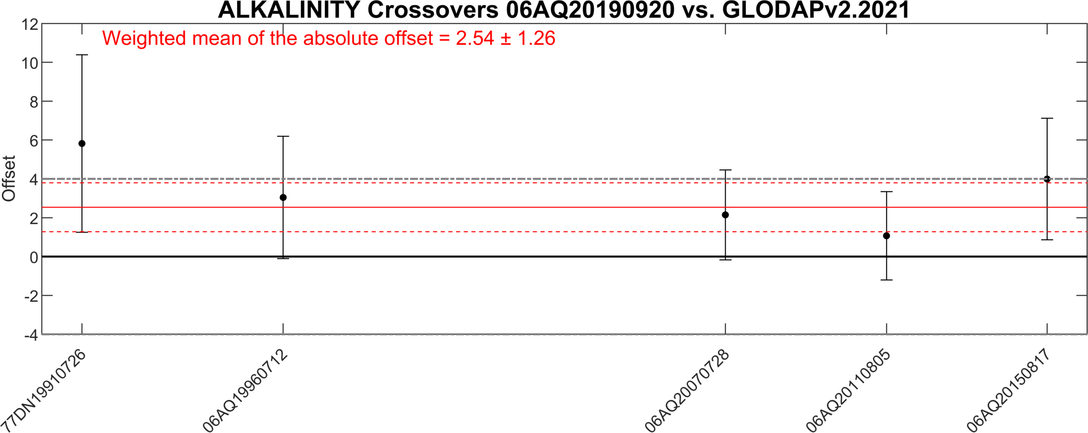
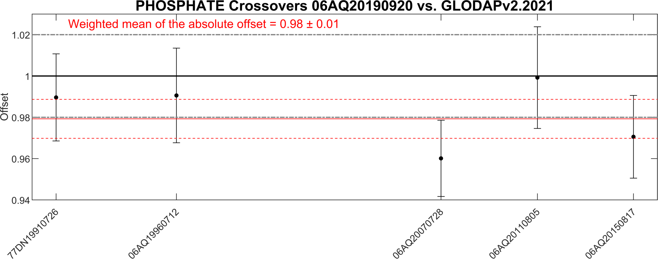
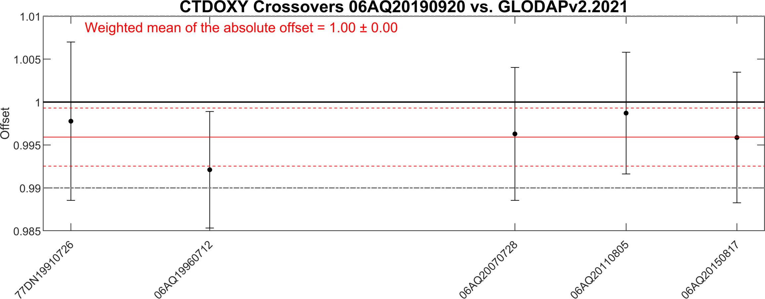
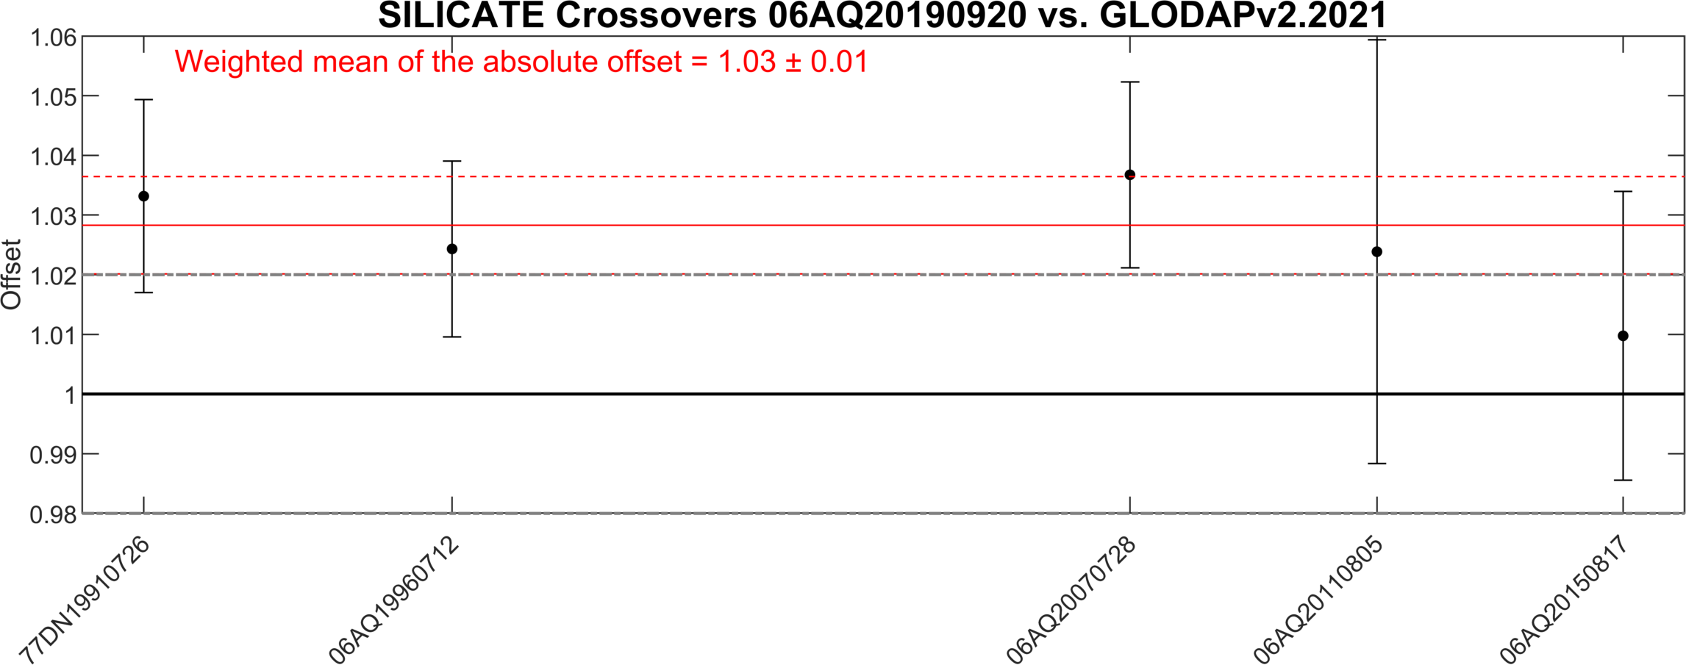
Crossover analysis (> 2500 dbar, 4 arcdeg)

Slide 13
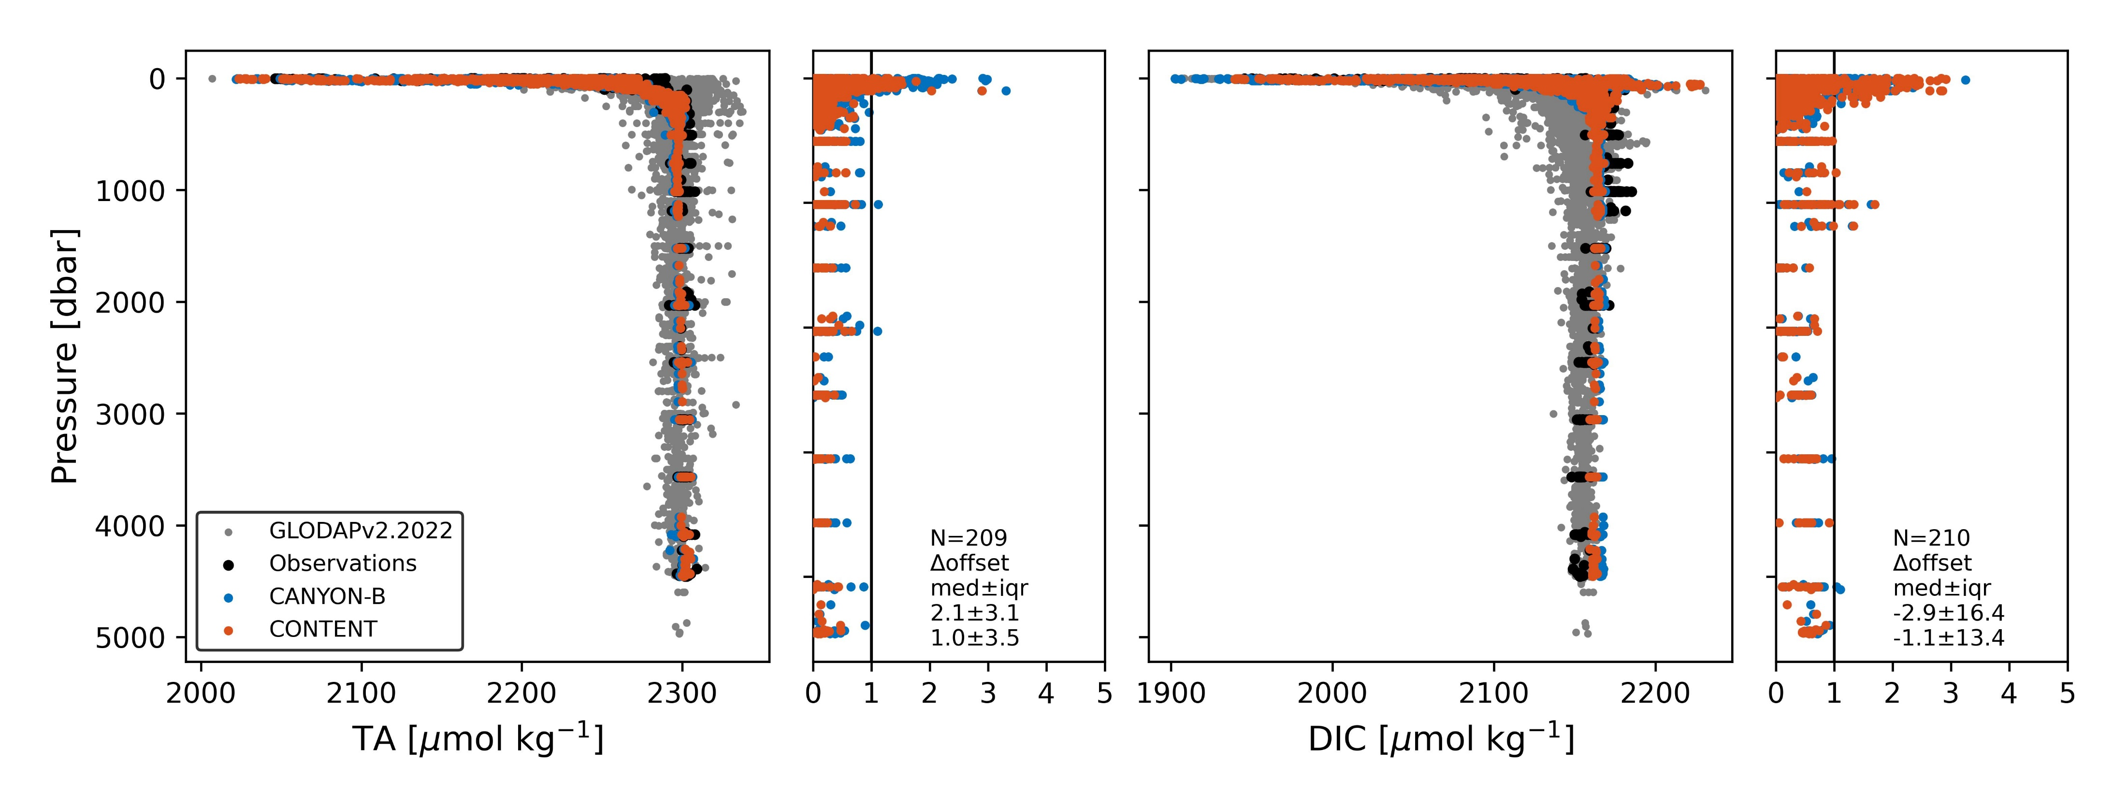

CANYON-B/CONTENT
(> 500 dbar)

